Slide 1

Story and Song: The Ballad
By Sam Adams

Slide 2
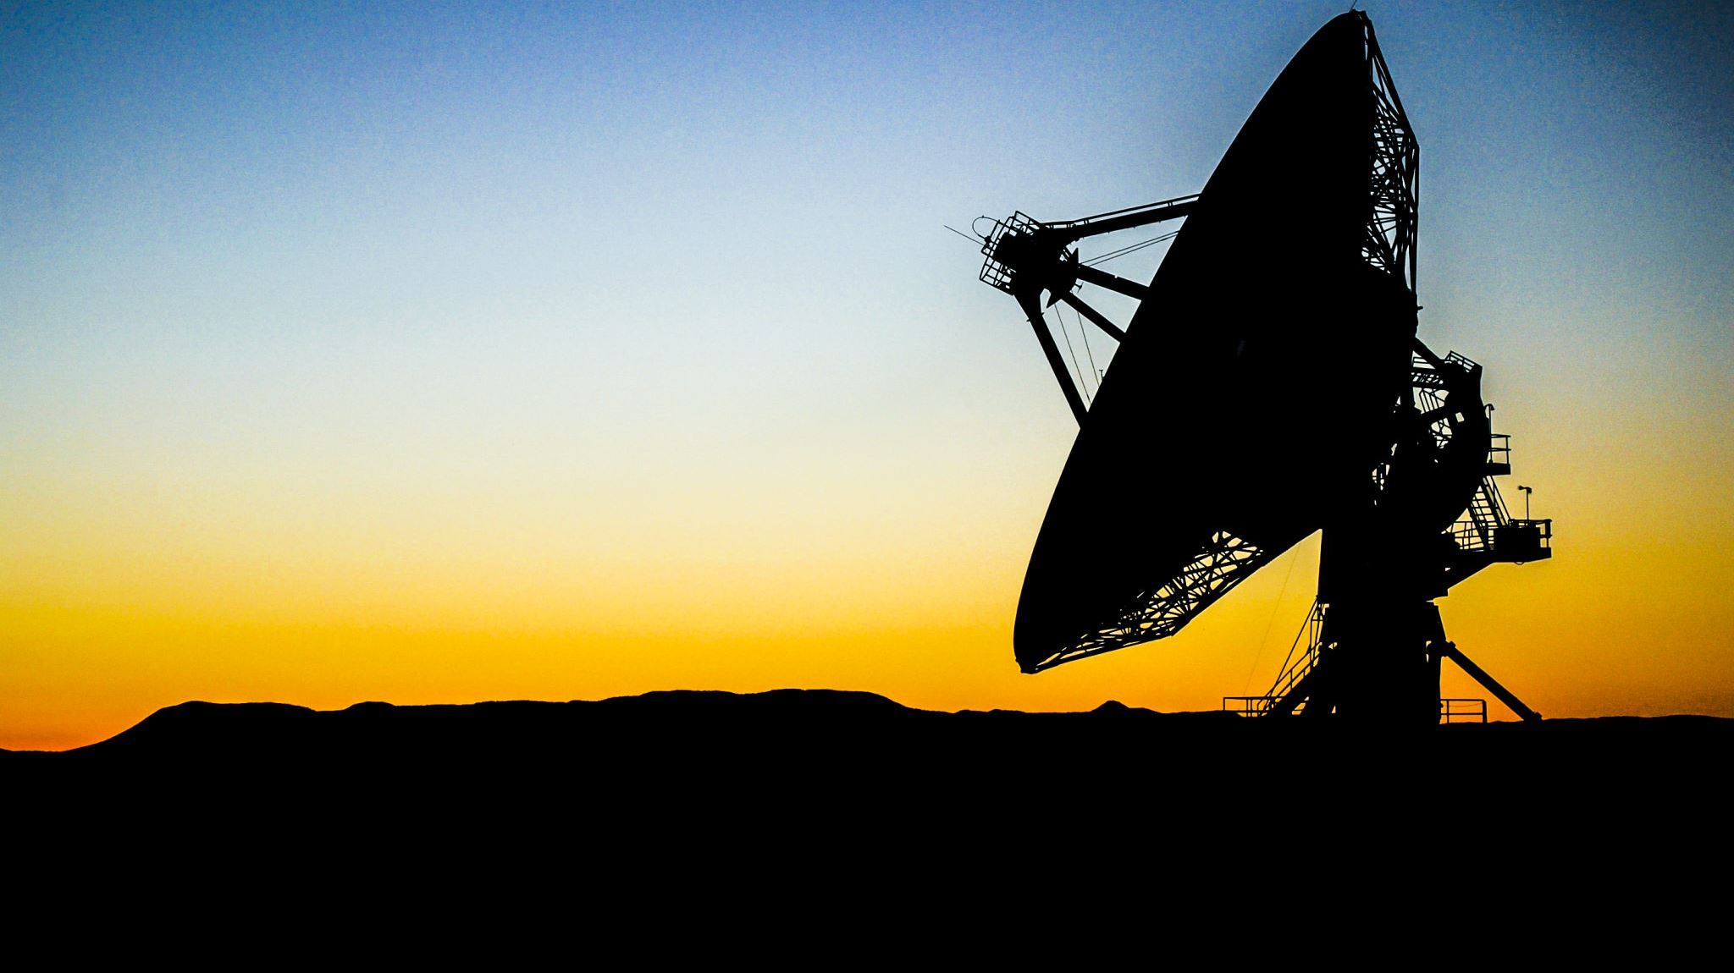
Jim Croce: Operator
(Folk Rock)

Slide 3

What was studied?
Why is it important?
What is my connection?

Slide 4

Ballads: Modern Definition
Tells a story.
Tends to be cultural or regional.
Follows a quatrain style of alternate rhyming lines.
Ranges in tempo.
Present in most musical genres today.

Slide 5
Common Ballad Themes
Love
Death
Loyalty/Betrayal
Honor/Glory
Magic/Supernatural
Conflict

Slide 6
European Origins, Worldwide Impact
Dated to medieval Europe and present in most countries.
Originated from traveling minstrels writing lyrical poetry for nobles.
Accompanied by music and encouraged dance.
Described a myriad of topics from love to war and local legends to cultural heroes.
Carried by traveling minstrels all over Europe and brought to America by emigrants.

Slide 7
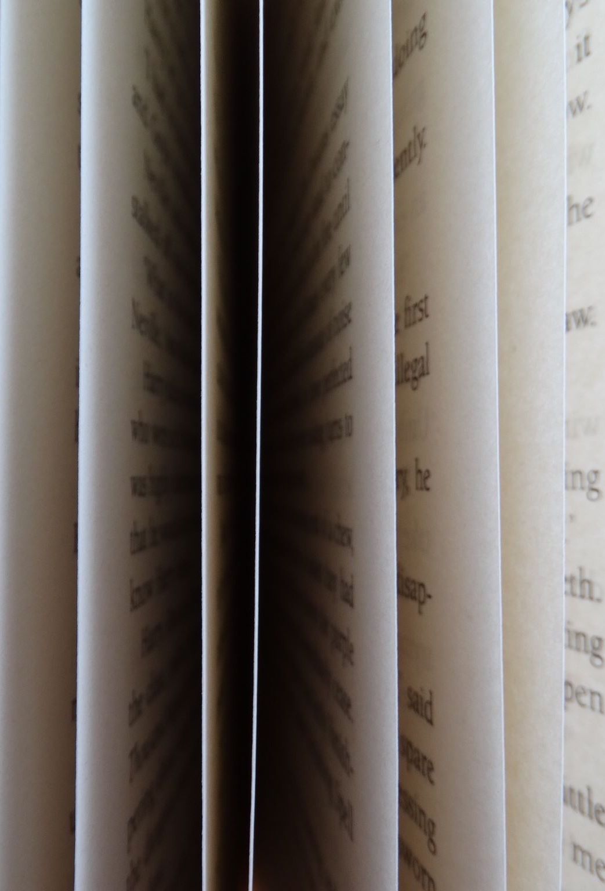
Historical Ballad Types
Folk ballad: Anonymous works handed down from generation to generation orally and often accompanied by music. Some well-recognized examples are Sir Patrick Spens and Barbara Allen.
Literary ballad: Works accredited to authors that are meant to be read. A familiar example is La Belle Dame Sans Merci.
Broadside ballad: Printed sheets of verse containing one or more ballads often with musical suggestions provided. These were sold cheaply by street vendors after the printing press was invented.

Slide 8
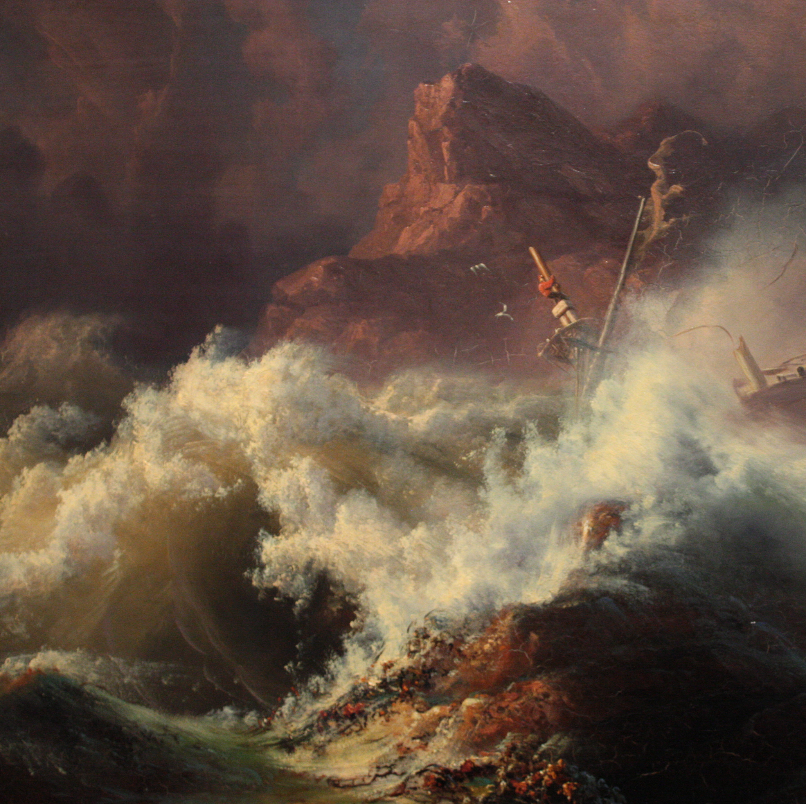
Folk Ballads: Sir Patrick Spens
Originated in Scotland.
Published as a broadside around 1765.
Tells the story of a sailor ordered by his king to carry nobles across the sea at the wrong time of the year. The ship sinks and all are lost.
Contains ballad themes of death, honor, and conflict of man vs. nature.

Slide 9
The king sits in Dumferling toune,
Drinking the blude-reid wine:
O quhar will I get guid sailor,
To sail this schip of mine?
Up and spak an eldern knicht,
Sat at the king’s richt knee:
Sir Patrick Spens is the best sailor
That sails upon the sea…
...
Have owre, have owre to Aberdour,
It’s fifty fadom deip:
And thair lies guid Sir Patrick Spens,
Wi’ the Scots lords at his feit.

Slide 10
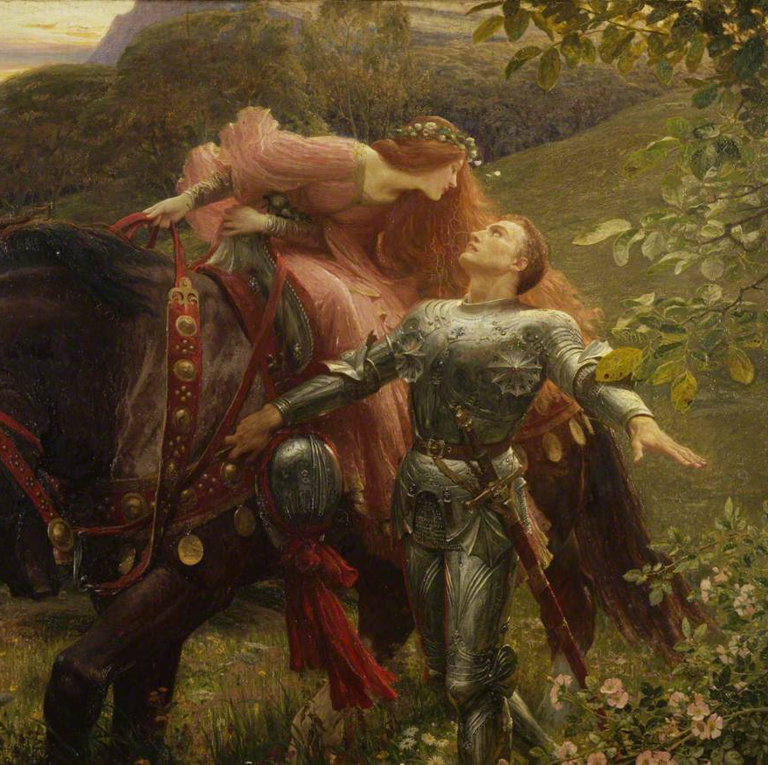
Literary Ballads: La Belle Dame sans Merci by John Keats
Written in 1819 and published in 1820.
Describes an encounter between a knight and a faery woman.
Explores themes of love, heartbreak, and magic.

Slide 11
O what can ail thee, knight-at-arms,
Alone and palely loitering?
The sedge has wither'd from the lake,
And no birds sing…
…
I met a lady in the meads,
Full beautiful—a faery's child,
Her hair was long, her foot was light,
And her eyes were wild….
…
And there she lullèd me asleep,
And there I dream'd—Ah! woe betide!
The latest dream I ever dream'd
On the cold hill's side…
…
And this is why I sojourn here,
Alone and palely loitering,
Though the sedge is wither'd from the lake,
And no birds sing.

Slide 12
American Adoption and Adaptation
Brought to America by European emigrants.
Spread as settlers did and added local lore and musical preferences.
Reincorporated French and Spanish influences into English ballads.

Slide 13
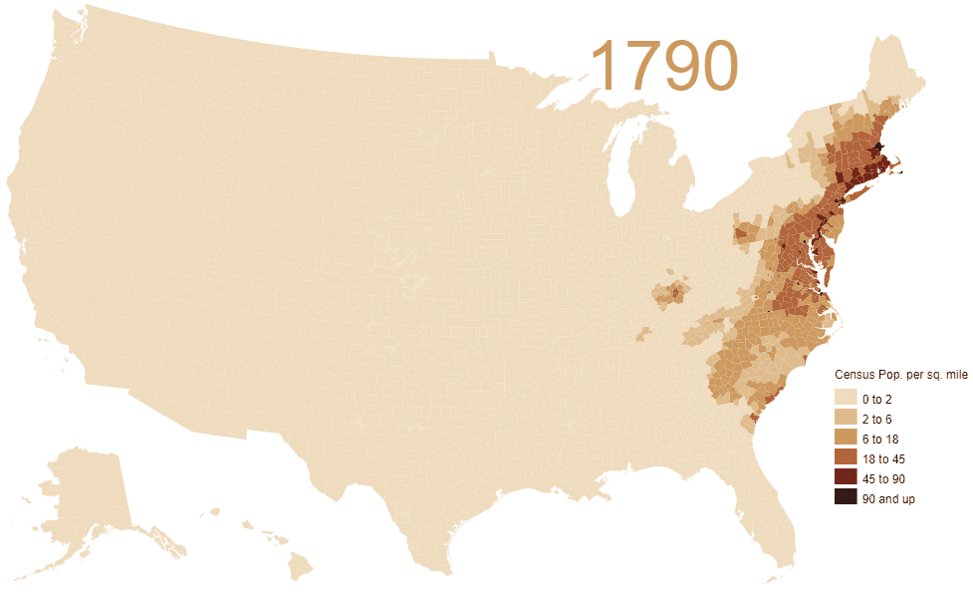

Slide 14
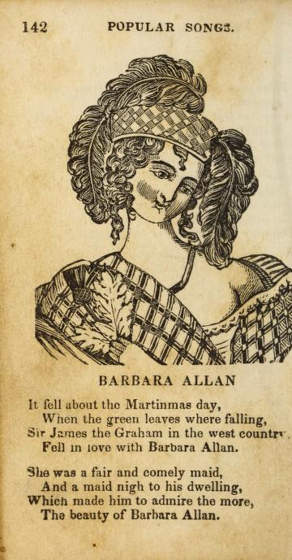
Evolution: Generational Ballads: Barbara Allan
Originated in Britain.
Referenced first in the 1660s, but popular in 18th-century Europe and colonial America.
Spread West with colonists and settlers.
Contains traditional ballad structure and themes.
Known as a “folk song” passed orally from generation to generation.
Known as a staple for modern balladeers.

Slide 15
In Scarlet town, where I was born,
There was a fair maid dwellin’,
Made every youth cry Well-a-way!
Her name was Barbara Allen.
All in the merry month of May,
When green buds they were swellin’,
Young Jemmy Grove on his death-bed lay,
For love of Barbara Allen.
He sent his man in to her then,
To the town where she was dwellin’;
“O haste and come to my master dear,
If your name be Barbara Allen.”
So slowly, slowly rase she up,
And slowly she came nigh him,
And when she drew the curtain by—
“Young man, I think you’re dyin’.”
“O it’s I am sick and very very sick,
And it’s all for Barbara Allen.”—
O the better for me ye’se never be,
Tho’ your heart’s blood were a-spillin’!
“O dinna ye mind, young man,” says she,
“When the red wine ye were fillin’,
That ye made the healths go round and round,
And slighted Barbara Allen?”
He turned his face unto the wall,
And death was with him dealin’:
“Adieu, adieu, my dear friends all,
And be kind to Barbara Allen!”
As she was walking o’er the fields,
She heard the dead-bell knellin’. And every jow the dead-bell gave
Cried “Woe to Barbara Allen.”
“O mother, mother, make my bed,
O make it saft and narrow:
My love has died for me today,
I’ll die for him tomorrow.”
“Farewell,” she said, “ye virgins all,
And shun the fault I fell in:
Henceforth take warning by the fall
Of cruel Barbara Allen.”

Slide 16
Evolution: The Americanization Of Lord Bateman
Changes with every generation. A prime example is the transformation of Lord Bateman into Lloyd Bateman.
Began as a tale of an English aristocrat.
Became the story of a gentleman from Georgia.
Swaps title name and some content, but story cues can stay the same.

Slide 17
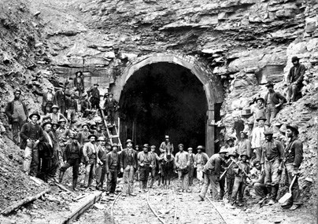
Evolution: An American Ballad: John Henry
Originated in West Virginia in the 1870s.
Created from work songs of laborers building railroads.
Tells of a uniquely American legend and hero.
Shows the struggle of man vs. industrialism.
Serves as a reminder of those who died constructing railroads.

Slide 18
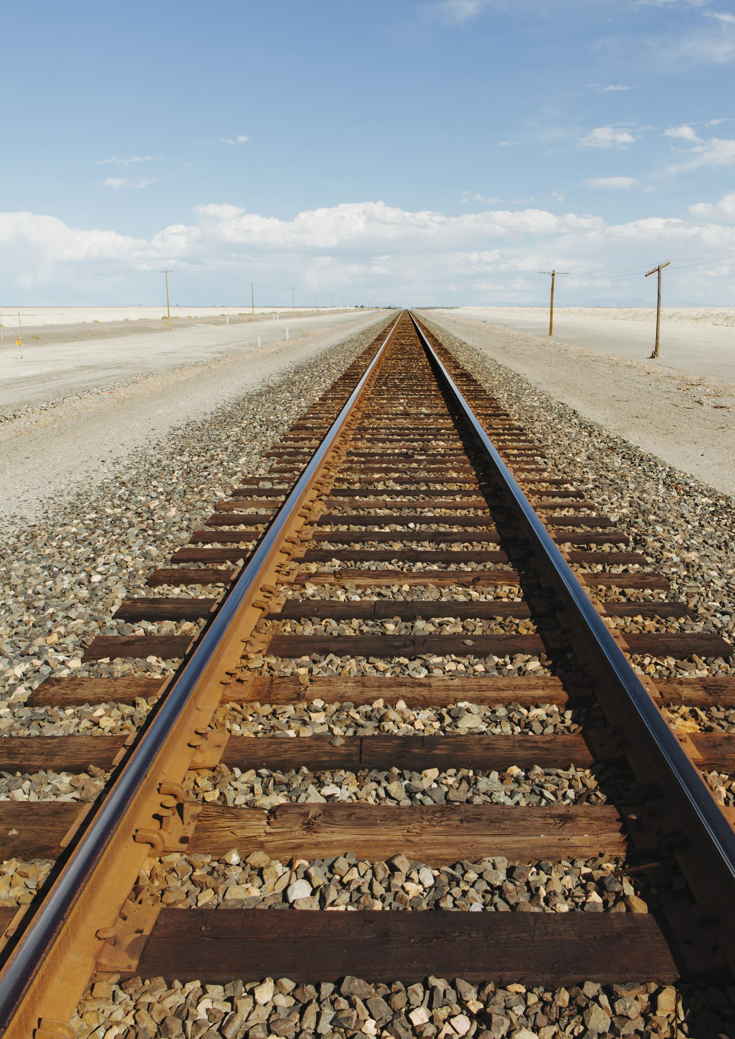
The captain said to John Henry
Gonna bring that steam drill ‘round.
Gonna bring that steel drill out on the job.
Gonna whop that steel on down, down down.
Gonna whop that steel on down
John Henry told his captain,
“A man ain’t nothin’ but a man,
But before I let your steam drill beat me down
I’d die with a hammer in my hand, Lord Lord
I’d die with a hammer in my hand”

Slide 19
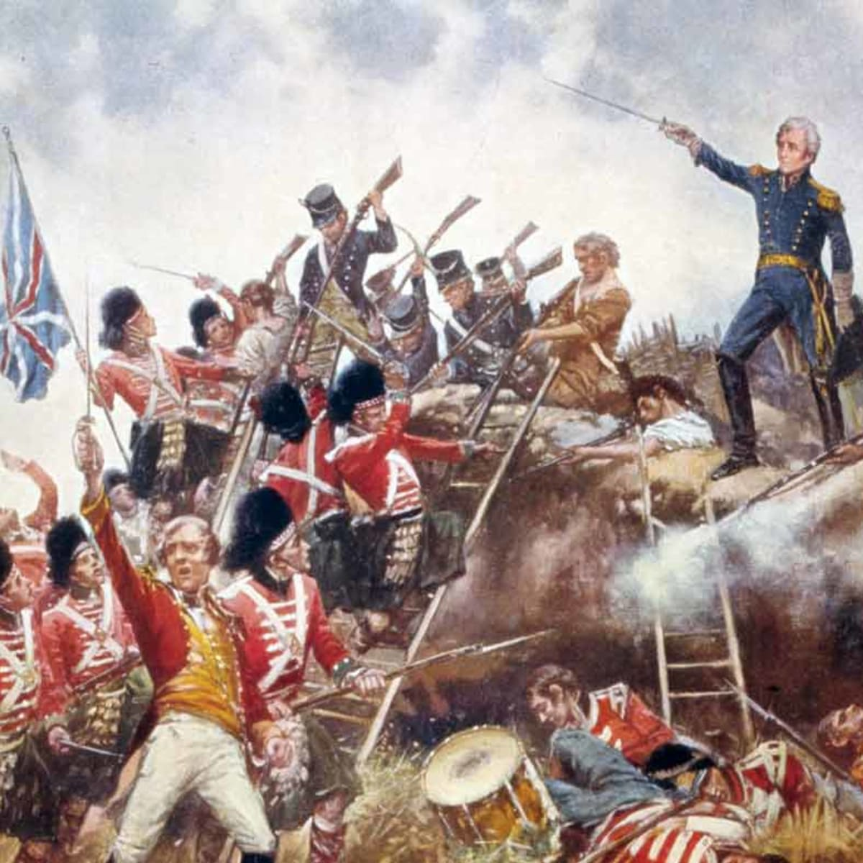
American Ballad: The Battle of New Orleans
Written by Jimmy Driftwood of Timbo, Arkansas in the mid-20th century.
Covered by Johnny Horton in 1959.
Describes a decisive American victory in the War of 1812 from the perspective of a soldier.
Won Grammys for both Driftwood and Horton.

Slide 20
In 1814 we took a little trip
Along with Colonel Jackson down the mighty Mississipp’
We took a little bacon and we took a little beans
And we caught the bloody British in the town of New Orleans
We fired our guns and the British kept a coming
There wasn’t nigh as many as there was a while ago
We fired once more and they began to running
Down the Mississippi to the Gulf of Mexico
We looked down the river and we seen the British come
And there must have been a hundred of them beating on the drums
They stepped so high and they made their bugles ring
We stood behind our cotton bales and didn’t say a thing
Old Hickory said we could take ’em by suprise
If we didn’t fire a musket ’til we looked ’em in the eyes
We held our fire ’til we seen their faces well
We opened up our squirrel guns and really gave ’em
Well they ran through the briars and they ran through the brambles
And they ran through the bushes where the rabbits couldn’t go
They ran so fast the hounds couldn’t catch ’em
On down the Mississippi to the Gulf of Mexico
We fired our cannon ’til the barrel melted down
Then we grabbed an alligator and we fought another round
We filled his head with cannonballs and powdered his behind
And when we touched the powder off the gator lost his mind

Slide 21
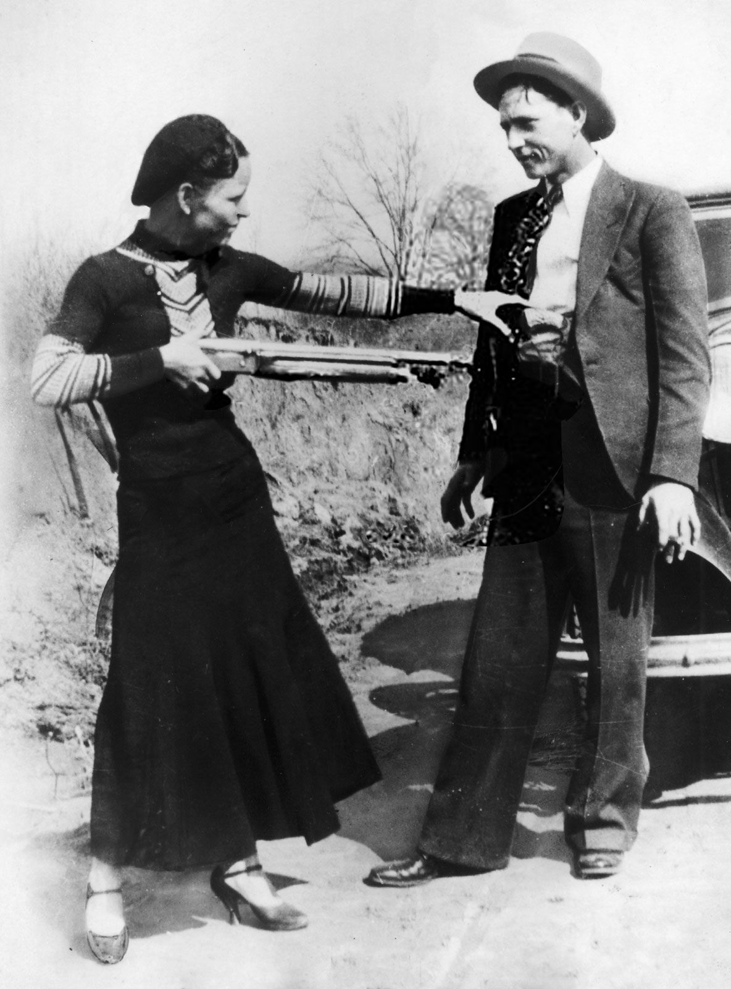
American Ballad: The Ballad Of Bonnie and Clyde
Written by Bonnie Parker in 1934.
Presented as a literary ballad.
Attempts to defend the honor of the infamous bank, gas station, and restaurant robbers.
Explains that they did not commit all of the crimes pinned on them.
Claims that many people supported them in their crime spree.
Presents the duo as Depression-era Robin Hoods.

Slide 22
Now Bonnie and Clyde are the Barrow Gang,
I’m sure you all have read
how they rob and steal and those who squeal
are usually found dying or dead.
There’s lots of untruths to these write-ups
They’re not so ruthless as that
Their nature is raw, they hate all law
Stool pigeons, spotters, and rats.
They call them cold-blooded killers
They say they are heartless and mean
But I say this with pride, I once knew Clyde
When he was honest and upright and clean.
…
The road was so dimly lighted
There were no highway signs to guide
But they made up their minds if all roads were blind
They wouldn’t give up 'til they died.
…
The road gets dimmer and dimmer
Sometimes you can hardly see
But it’s fight man to man, and do all you can
For they know they can never be free.
If a policeman is killed in Dallas
And they have no clue or guide
If they can’t find a fiend, just wipe the slate clean
And hang it on Bonnie and Clyde.
There’s two crimes committed in America
Not accredited to the Barrow Mob
They had no hand in the kidnap demand
Nor the Kansas City Depot job.
A newsboy once said to his buddy
"I wish old Clyde would get jumped
In these hard times we’s get a few dimes
If five or six cops would get bumped."

Slide 23
Billboard’s Chartbusting American Ballads
Marty Robbins - El Paso. #1 Spot. 2 Weeks. 22 in total.
Gordon Lightfoot – Wreck of the Edmund Fitzgerald. #2 Spot. 21 Weeks.
Charlie Daniels Band - The Devil Went Down To Georgia. #3 Spot. 18 Weeks.

Slide 24

Arlo Guthrie: City of New Orleans

Slide 25
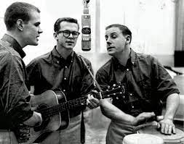
Evolution: Murder Ballads: Tom Dooley
Originated as a folk ballad in North Carolina.
Based on the legend of Tom Dula.
Tells of Dula’s love for Laura Foster, which made Anne Melton jealous. Melton murders Foster, and Dula is executed for the murder that he did not commit.
Made nationally famous by the Kingston Trio in 1958.
Hit #1 on the billboards.

Slide 26
[Chorus]
Hang down your head, Tom Dooley
Hang down your head and cry
Hang down your head, Tom Dooley
Poor boy, you're bound to die
[Verse 1]
I met her on the mountain
There I took her life
Met her on the mountain
Stabbed her with my knife
[Chorus]
[Verse 2]
This time tomorrow
Reckon where I'll be
Hadn't-a been for Grayson
I'd-a been in Tennessee
[Chorus]
[Verse 3
This time tomorrow
Reckon where I'll be
Down in some lonesome valley
Hangin' from a white oak tree

Slide 27

Evolution: Western/Cowboy Ballads
Written by cowboys and ranchers.
Adapted frequently from pre-existing songs.
Depicts legends of gunslingers, cowboys’ daily lives, and tall tales.
Sung by cowboys and settlers alike.
Became modern country/western and folk music.
Includes such songs as Big Iron, The Old Chisolm Trail, and Springfield Mountain.

Slide 28

Bob Dylan: Don’t Think Twice

Slide 29
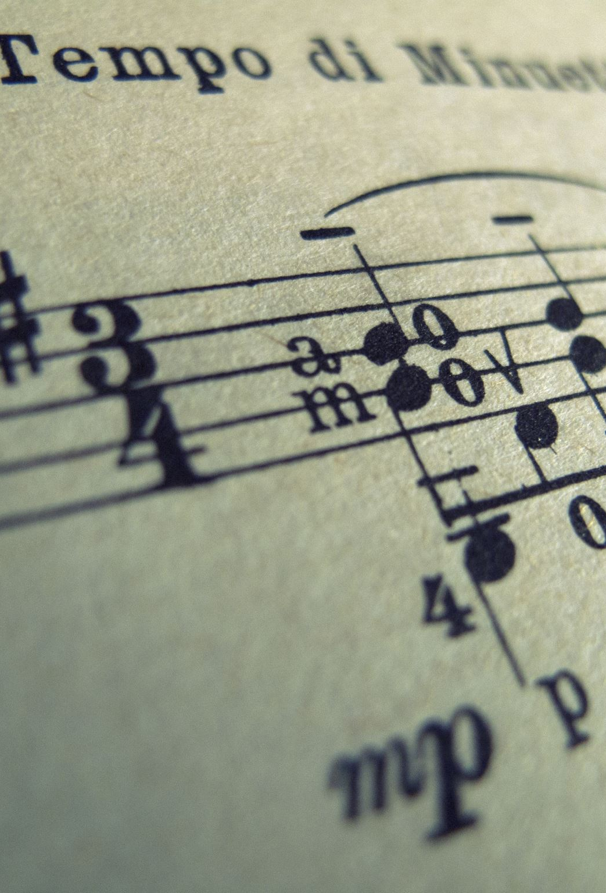
Evolution: Blues Ballads
Originated from blues-style music during the Harlem Renaissance.
Fuses jazz, gospel, and blues with ballad storytelling.
Includes ballads like Stagger Lee, and Nobody Knows You (When You’re Down and Out).

Slide 30
Jimmy Cox: Nobody Knows You (When You’re Down and Out)

Slide 31

Evolution: Power Ballads
Associated with rock music and its many subgenres.
Characterized by slow tempo and powerful lyrics.
Changed the ballad’s main theme from death to romantic love.
Includes such songs as I Wanna Know What Love Is by Foreigner, Kiss from a Rose by Seal, and Operator by Jim Croce.

Slide 32
What did I expect to find?

Slide 33
What did I discover? Why is it meaningful?

Slide 34
Sources
Encyclopædia Britannica, inc. (n.d.). Ballad. Encyclopædia Britannica. Retrieved February 25, 2023, from https://www.britannica.com/art/ballad (slides 3 and 4)
Music 101: What is a ballad? learn to write a ballad with examples - 2023. MasterClass. (2021, August 10). Retrieved February 25, 2023, from https://www.masterclass.com/articles/music-101-what-is-a-ballad-learn-to-write-a-ballad-with-examples (slide 3)
Traditional ballads : traditional and ethnic : musical styles : articles and essays : the library of Congress celebrates the songs of America : digital collections : library of Congress. The Library of Congress. (n.d.). Retrieved February 25, 2023, from https://www.loc.gov/collections/songs-of-america/articles-and-essays/musical-styles/traditional-and-ethnic/traditional-ballads/ (slides 4,5, and 10)
Turito. (2022, August 30). Ballads: Types, structure and characteristics: Turito. US Learn. Retrieved February 25, 2023, from https://www.turito.com/learn/english/ballads-grade-6 (slide 5)

Slide 35
Sources
“Sir Patrick Spens.” Encyclopedia.com, Encyclopedia.com, https://www.encyclopedia.com/arts/educational-magazines/sir-patrick-spens
Britton, Tom. “Murder Ballad Monday: ‘The Tear Blindit His EE’ - the Story of ‘Sir Patrick Spens.’” Sing Out!, Sing Out!, 28 Sept. 2015, https://singout.org/sir-patrick-spens/
“La Belle Dame sans Merci.” Encyclopædia Britannica, Encyclopædia Britannica, Inc., https://www.britannica.com/topic/La-Belle-Dame-sans-merci-by-Keats
“La Belle Dame Sans Merci.” Encyclopedia.com, Encyclopedia.com, https://www.encyclopedia.com/arts/educational-magazines/la-belle-dame-sans-merci
“La Belle Dame sans Merci.” La Belle Dame sans Merci | Art UK, Bristol Museum and Art Gallery, https://artuk.org/discover/artworks/la-belle-dame-sans-merci-188451
“American Roots Music : Eternal Songs - Folk Songs and Ballads.” PBS, Public Broadcasting Service, 2001, https://www.pbs.org/americanrootsmusic/pbs_arm_es_folkballad.html (Slide 6)
Desjardins, J. (2019, March 12). Visualizing 200 years of U.S. population density. Visual Capitalist. Retrieved March 5, 2023, from https://www.visualcapitalist.com/visualizing-200-years-of-u-s-population-density/ (Slide 7)
Beviglia, Jim. “Behind the Song: The Traditional ‘Barbara Allen’ - American Songwriter.” Behind The Song: The Traditional “Barbara Allen,” 14 Sept. 2020, https://americansongwriter.com/barbara-allen-behind-the-song/ (Slide 8)
“A. L. Lloyd – Lord Bateman.” Genius, https://genius.com/A-l-lloyd-lord-bateman-lyrics

Slide 36
Sources
Anonymous. “Barbara Allen by Anonymous.” Poetry Foundation, Poetry Foundation, https://www.poetryfoundation.org/poems/50273/barbara-allen (Slide 9)
“The Legend of John Henry: Talcott, WV.” National Parks Service, U.S. Department of the Interior, 22 Jan. 2020, https://www.nps.gov/neri/planyourvisit/the-legend-of-john-henry-talcott-wv.htm#:~:text=As%20the%20C%26O%20Railway%20stretched,John%20Henry%20became%20a%20symbol (Slide 11)
“" John Henry.’” The Library of Congress, https://www.loc.gov/item/ihas.200196572/ (Slide 11)
Seeger, Pete. “John Henry.” Pete Seeger - John Henry Lyrics | Lyrics.com, https://www.lyrics.com/lyric/1057163/Pete+Seeger/John+Henry
“Battle of New Orleans: War of 1812 & Andrew Jackson - History.” History.com, 9 Nov. 2009, https://www.history.com/topics/19th-century/battle-of-new-orleans
“Battle of New Orleans.” Bluegrass Lyrics, https://www.bluegrasslyrics.com/song/battle-of-new-orleans/
London, Amanda. “‘The Battle of New Orleans’ by Johnny Horton.” Song Meanings and Facts, 10 June 2021, https://www.songmeaningsandfacts.com/the-battle-of-new-orleans-by-johnny-horton/
“Bonnie and Clyde.” Encyclopædia Britannica, Encyclopædia Britannica, Inc., https://www.britannica.com/biography/Bonnie-and-Clyde-American-criminals
Rosenberg, Jennifer. “Read Bonnie Parker's Poem 'The Story of Bonnie and Clyde'.” ThoughtCo, ThoughtCo, 5 Aug. 2019, https://www.thoughtco.com/bonnie-parker-poem-bonnie-and-clyde-1779293#:~:text=Bonnie%20Parker%20wrote%20the%20poems,the%20couple%20was%20gunned%20down
“Marty Robbins.” Billboard, https://www.billboard.com/artist/marty-robbins/ (Slide 12)
“Gordon Lightfoot.” Billboard, https://www.billboard.com/artist/gordon-lightfoot/ (Slide 12)
“The Charlie Daniels Band.” Billboard, https://www.billboard.com/artist/the-charlie-daniels-band/ (Slide 12)

Slide 37
Sources
“The Legend of Tom Dooley.” The Legend of Tom Dooley | North Carolina Ghosts, https://northcarolinaghosts.com/mountains/tom-dooley/ (Slide 13)
“The Kingston Trio.” Billboard, https://www.billboard.com/artist/the-kingston-trio/ (Slide 13)
Beacham, Frank. “On This Day in 1958 - 64 Years Ago Today - the Kingston Trio's ‘Tom Dooley’ Hit #1 on the Billboard Popular Music Chart.” Frank Beacham's Journal, 17 Nov. 2022, https://www.beachamjournal.com/journal/2022/11/on-this-day-in-1958-64-years-ago-today-the-kingston-trios-tom-dooley-hit-1-on-the-billboard-popular-music-chart.html (Slide 13 picture)
“The Kingston Trio – Tom Dooley.” Genius, https://genius.com/The-kingston-trio-tom-dooley-lyrics
Hull, Myra. “Cowboy Ballads.” Kansas Historical Society, Feb. 1939, https://www.kshs.org/p/cowboy-ballads/12777#:~:text=Cowboy%20songs%20are%20ballads%3B%20that,origin%20was%20lost%20in%20antiquity
“Power Ballad.” POWER BALLAD Definition | Cambridge English Dictionary, https://dictionary.cambridge.org/us/dictionary/english/power-ballad (Slide 14)

