Slide 1


ASU System
Title IX Coordinators
Grievance Procedures Training
November 14, 2025

Slide 2
ASU System Title IX
(Sexual Harassment Discrimination)
Grievance Procedure

Slide 3
Step 1: Report
Policy Requirements:
  Contact – 2 business days
  Notify – Supportive Measures
  Inform – Formal Complaint Process
  Warn – Code of Conduct/False Reports
Other Actions: Analyze and discuss jurisdictional issues and other procedures, as appropriate, with Complainant

Slide 4
Step 1: Report (cont’d)
Question 1: Does the report involve an alleged victim who was participating or attempting to participate in our education program or activity?
  If Yes: Go to Question 2
  If No:
    Explain to Complainant allegations are outside of our Title IX jurisdiction
    Offer any support or resources you can, which can include assistance with referring the matter to student conduct or assisting with reporting to local police

Slide 5
Step 1: Report (cont’d)
Question 2: Does the report allege sex-based discrimination?
  Use the broadest definition at this point
  If Yes: Go to Question 3
    Need to identify which grievance procedure applies – Sexual Harassment Discrimination (SHD) or Other Sex-Based Discrimination (OSBD)
  If No:
    Explain to Complainant neither sex discrimination procedure applies
    Offer any support or resources you can, which can include assistance with referring the matter to student conduct or assisting with reporting to local police

Slide 6
Step 1: Report (cont’d)
Question 3: Did the activity allegedly occur in the U.S.?
  If Yes: Go to Question 4
  If No: Use the OSBD

Slide 7
Step 1: Report (cont’d)
Question 4: Did the activity allegedly occur in a location or under circumstances over which the campus exercises substantial control?
  If Yes: Go to Question 5
  If No: Use the OSBD

Slide 8
Step 1: Report (cont’d)
Question 5: Does the alleged conduct meet the definition of “Sexual Harassment Discrimination” under SHD?
  If Yes: Must use the SHD
  If No: Must use the OSBD
  If Close Call:
    Use SHD, but explain to Complainant that you might have to dismiss their complaint after Notice of Allegations, but OSBD would then be available

Slide 9
Step 2: Formal Complaint
If Complainant files a Formal Complaint: Continue to Step 3
If Complainant decides not to file a Formal Complaint:
  Assist the Complainant with continued supportive measures
  Determine whether you will sign a Formal Complaint
    Only sign if, based on the facts then available, failure to sign would be clearly unreasonable and would amount to deliberate indifference

Slide 10
Step 3: Notice of Allegations
Prepare the Notice of Allegations
  Double-check all required elements of notice from policy
Submit Notice of Allegations to both parties simultaneously

Slide 11
Step 4: Screening
Screen Formal Complaint for SHD Jurisdiction
  Allegations meet definition of Sexual Harassment Discrimination
  Allegedly occurred in school’s education program or activity
  Allegedly occurred in U.S.
  Allegedly occurred in a location or under circumstances over which the campus exercises substantial control

Slide 12
Step 4: Screening (cont’d)
Possible Outcomes:
  Mandatory Dismissal
  Discretionary Dismissal (and appeal rights)
  Investigation

Slide 13
Step 4: Screening (cont’d)
Mandatory Dismissal
  If any SHD jurisdictional element is absent, then:
    Dismiss Formal Complaint under SHD
    Offer Complainant option to proceed under OSBD

Slide 14
Step 4: Screening (cont’d)
Discretionary Dismissal
  If all SHD elements are present,
    But:
      Complainant requests in writing to withdraw allegation for Formal Complaint; or
      Circumstances prevent gathering enough evidence to make a determination;
    Then:
      Title IX Coordinator may dismiss Formal Complaint
      Both parties have right to appeal discretionary dismissal
      May not initiate other procedure after discretionary dismissal

Slide 15
Step 5: Investigation
Investigation basics:
  45 business days
  Impartial
  Consider all inculpatory and exculpatory evidence
  Interview: Complainant, Respondent, all identified witnesses
  Review: All documentary evidence

Slide 16
Step 5: Investigation (cont’d)
Investigation guardrails:
  No privileged info unless privilege waived
  No sexual history or predisposition info unless offered to prove:
    Someone else committed alleged act; or
    Sexual history between C and R to prove consent
  No credibility assessments based on status as C or R
  Written notice of 2 business days before any meeting or interview where party’s presence is requested
  Continue to assess and reassess supportive measures

Slide 17
Step 6: End of Investigation
Possible Outcomes
  Informal Resolution
  Evidence Review by Parties

Slide 18
Step 6: End of Investigation (cont’d)
Informal Resolution
  If proposed, describe the procedure
  May not use when:
    C is a student; and
    R is a staff or faculty member
  If successful: Close case
  If unsuccessful:
    Proceed to parties’ review of evidence
    Documents from informal resolution process provided to Hearing Committee

Slide 19
Step 6: End of Investigation (cont’d)
Evidence Review by Parties
  Provide all evidence from investigation to parties and their advisors simultaneously.
  Parties have 10 business days to review and provide any written response
  Title IX Coordinator/investigator reviews any responses
  Responses included in Investigative Report

Slide 20
Step 7: Investigative Report
Required elements:
  Timeline of investigation, beginning with Formal Complaint
  Allegations from Formal Complaint
  All relevant evidence gathered in investigation
  Specific form of sex discrimination alleged
  Parties’ responses to the evidence
Review and Response:
  Parties permitted 10 business days after receiving Investigative Report before hearing and may submit a written response to report

Slide 21
Step 8: Hearing
Title IX Coordinator/Investigator’s Role:
  Provide Investigative Report and responses to Hearing Committee Chair (HR rep)
  Appear as witness at hearing, if called
  Continue to provide supportive measures

Slide 22
Step 9: Hearing Committee’s Determination
Title IX Coordinator/Investigator’s Role:
  Note: Title IX Hearing Committee will issue Written Determination to parties and Hearing Committee Chair within 20 business days of hearing
  Continue to provide supportive measures
  Refer process questions to Hearing Committee Chair
  Do not consult with Hearing Committee members

Slide 23
Step 10: Appeal
Title IX Coordinator/Investigator’s Role:
  Note: Parties have 5 business days to submit appeal to Hearing Committee Chair
  Continue to provide supportive measures
  Refer process questions to Hearing Committee Chair
  Do not consult with parties concerning their appeal or with Appeal Committee members

Slide 24
Step 11: Appeal Committee’s
Written Recommendation
Title IX Coordinator/Investigator’s Role:
  Note: Appeal Committee has 10 business days to after receipt of Appeal Packet from Hearing Committee Chair to submit Written Recommendation to Chancellor:
    Appeal not supported by evidence, and affirm Hearing Committee; or
    Appeal is supported by evidence, and
      Overturn Hearing Committee; or
      Confirm Hearing Committee finding, but modify sanctions or remedial measures
  Continue to provide supportive measures.
  Refer process questions to Hearing Committee Chair
  Do not consult with parties concerning their appeal or with Appeal Committee members

Slide 25
Step 12: Chancellor’s Final Decision
Title IX Coordinator/Investigator’s Role:
  Note: Chancellor has 10 business days to review Appeal Packet and Written Recommendation and issue Final Decision
  Continue to provide supportive measures
  Refer process questions to Hearing Committee Chair
  Do not consult with parties concerning their appeal or with Chancellor

Slide 26
Step 13: Aftermath
Title IX Coordinator/Investigator’s Role:
  Coordinate enforcement with campus administrators
  Continue to provide supportive measures
  Collect all documents and ensure retention for 7 years

Slide 27
ASU System Title IX
Other Sex-Based Discrimination
Grievance Procedure

Slide 28
Grievance Issues
Catchall when SHD does not apply:
  Allegations of sex-based discrimination other than “Sexual Harassment Discrimination”
  Allegations of “Sexual Harassment Discrimination” occurring outside of SHD jurisdiction
  Allegations of retaliation reporting or participating in a claim of sex-based discrimination
  Allegations of any activity prohibited by 34 CFR § 106.31(b)

Slide 29
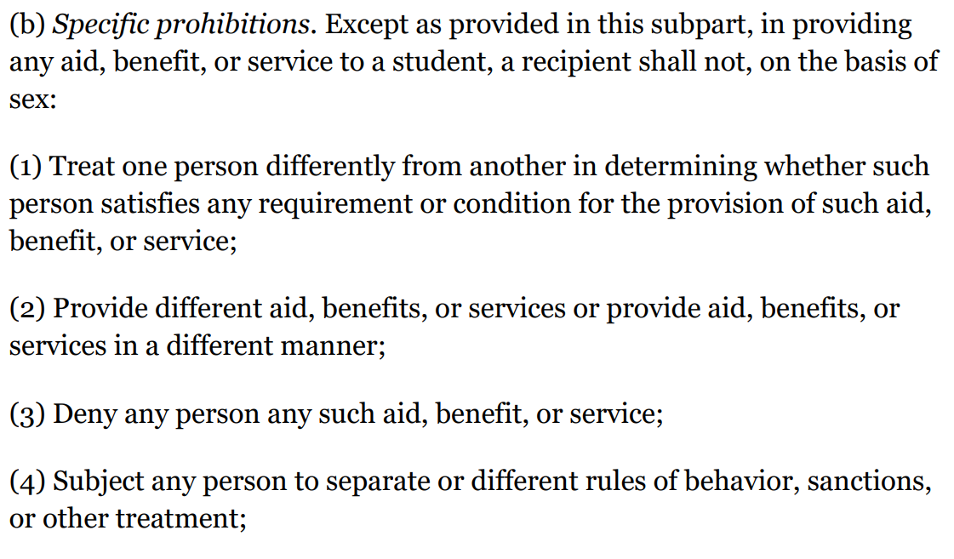

Slide 30
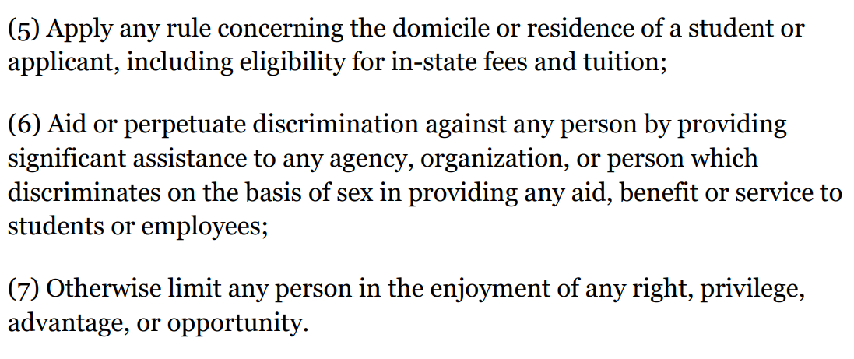

Slide 31
Grievance Issues (cont’d)
Limitations:
  Allegations subject to SDH
  Alleged C was not participating or attempting to participate in an education program or activity of the institution
  Allegations of actions permitted by 34 CFR § 106.14
    Fraternities/Sororities
    YMCA, YWCA, Girl Scouts, Boy Scouts, Camp Fire Girls
    Voluntary youth service organizations (non-profits for members under 19)

Slide 32
Screening
The only other significant difference from the SHD is that the Title IX Coordinator’s screening function (immediately following the Notice of Allegations) is limited to determining whether the Formal Complaint is grievable under the OSBD

Slide 33
Investigation Through Appeal
All remaining aspects of the OSBD (investigation, informal resolution, hearing, appeal) follow the same procedures as the SHD

