Slide 1


NEURODIVERSITY
IN THE RURAL COMMUNITY COLLEGE
2
0
1
9
APEX
PRESENTATION BY ABRAHAM UNWER
Notes:
INTRO w/interests First let’s look at the GOAL of this presentation along with definitions of NEURODIVERSITY and composition of a RURAL COMMUNITY COLLEGE. You tell a little about yourself and why you choose this topic
“So, let’s start by taking a look at the
PURPOSE of this presentation
A definition of Neurodiversity, and
How community colleges differ from larger colleges.”

Slide 2
Purpose of the Presentation
To share useful, accurate information about neurodiversity
To open conversations and interactions within the community

Slide 3
What did I study,
and why is it important?

Slide 4
What did I study, and why is it important?
The topic of neurodiversity has a special place in my heart due to my unique personal experience with dyslexia and having neurodivergent family members.
Many in our community are underinformed about the challenges and strengths of the neurodiverse population. Divergent thinkers come up with new ideas that have the potential to make great advances. This has always been true.
It is therefore important for us to better understand the neurodiverse population and better integrate it into the educational system, the community, and the work force. For us, this gateway begins at our rural community college.

Slide 5
What did I expect to find,
and why?

Slide 6
What did I expect to find, and why?
As I began this study, I expected to find standard guidelines and clear, concise information about neurodiversity and the neurodiversity movement. After all, this movement has been in process since the 1990s.
I assumed the literature would affirm my comprehension of the three conditions of focus (dyslexia, ADHD, and Asperger's Syndrome), because I have personal or direct experience with these conditions.
I expected to garner a brief list of useful facts and ideas that would improve the general understanding of neurodiversity. I was used to the accommodations that were available at the high school level.
I anticipated that the cost of implementing services and accommodations specific to the needs of this population would be cost-preventive.

Slide 7
The Neurodiversity Concept
"...a concept where neurological differences are to be recognized and respected as any other human variation. These differences can include those labeled with Dyspraxia, Dyslexia, Attention Deficit Hyperactivity Disorder, Dyscalculia, Autistic Spectrum, Tourette Syndrome, and others."
― National Symposium on Neurodiversity (2011)
held at Syracuse University, New York

Slide 8
Neurodiversity is…
A collection of
Naturally Occurring
Neurological Conditions
Marked by
Difficulties in executive functioning
Increased creativity

Slide 9
Executive Function Defined
“Executive functions refer to a family of top-down mental processes needed when you have to concentrate and pay attention, when going on automatic or relying on instinct or intuition would be ill-advised, insufficient, or impossible.”
― Adele Diamond
Adele Diamond is the Tier 1 Canada Research Chair Professor
of Developmental Cognitive Neuroscience at the University of British Columbia, a Fellow of the Royal Society of Canada, and was recently listed
as one of the 15 most influential neuroscientists.

Slide 10
Elements of Executive Function
Organizing
Planning
Prioritizing
Initiating
Persisting

Slide 11
Misconceptions About Neurodiversity
The public often believes it is better informed than it actually is.
Conceptions of neurodiversity are over-simplified as well as amplified.
The public is uncertain about how to support these students.
Notes:
For example, dyslexia is much more complicated that transposing letters, and people with Asperger’s Syndrome are not mental deficient.

Slide 12
DYSLEXIA SLIDE TO MAKE BLANK
Dyslexia

Slide 13
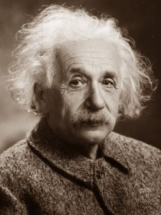
What is Dyslexia?
Dyslexia is a specific learning disability that is neurobiological in origin. It is characterized by difficulties with accurate and/or fluent word recognition and by poor spelling and decoding abilities.
― International Dyslexia Association
Albert Einstein - Theoretical physicist

Slide 14
Dyslexia Facts
First written description, 1896
“Dyslexia” from Greek, “difficult words or language”
Originally called reading blindness
Not a visual impairment
Lack of phonetic awareness
Reading learned through a multi-sensory approach

Slide 15
More Dyslexia Facts
Dyslexia impacts 10-20% of the population.
Boys and girls are affected equally.
Dyslexia is the leading cause of student dropout.
Up to 90% of all learning disabilities are rooted in dyslexia.
Dyslexia is not outgrown.

Slide 16

Signs of Dyslexia
Difficulty writing and reading aloud
Inconsistently misspelled words
Poor reading comprehension
Reading inaccuracies
Trouble outlining
Tom Cruise - Actor

Slide 17

More Signs of Dyslexia
Problems with planning and time management
Difficulty keeping up with objects
Difficulty with deadlines
Orlando Bloom - Actor

Slide 18
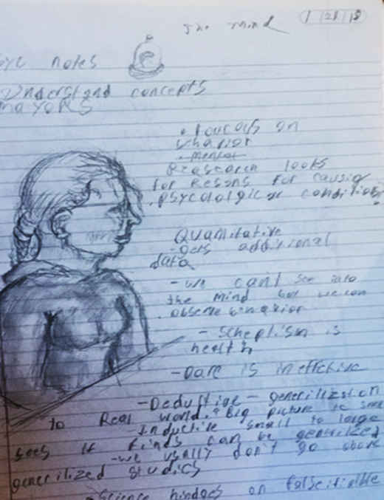
Dyslexia is often coupled with dysgraphia. This is an example from a class notebook.

Slide 19

Dyslexia in the Classroom
Dyslexia manifests as
Difficulty writing down thoughts
Loss of words when speaking
Above average artistic skill
Poor penmanship
Steven Spielberg - Film director, producer, screenwriter

Slide 20

Strengths of a Person with Dyslexia
Right-brain dominant
Strong intuition, art, and emotion
Synthesizing ideas, creativity
Thinking “outside the box”
Seeing the "big picture"
Spatially talented - 3D
Pattern recognition
Steve Jobs - Co-founder, Chairman, and CEO of Apple Inc.
Primary investor and Chairman of Pixar

Slide 21
Common Career Interests
Engineer
Architect
Designer
Artist
Mathematician
Physicist
Surgeon
Dentist

Slide 22
Support for Students with Dyslexia
Outlines, notes, and study guides in advance
Assignments broken into smaller tasks
Audio books and text-to-speech
Quiet place to work
Extra time

Slide 23
More Support
Deal with content and spelling issues separately.
Use alternative ways to assess knowledge.
Reinforce individual coping techniques
Do not ask them to read aloud in class.

Slide 24
DYSLEXIA SLIDE TO MAKE BLANK
ADHD

Slide 25
What is ADHD?
Attention-deficit/hyperactivity disorder (ADHD) is a brain disorder marked by an ongoing pattern of inattention and/or hyperactivity-impulsivity that interferes with functioning or development.
― National Institute of Mental Health

Slide 26
Facts about ADHD
The first descriptions of ADHD symptoms were made around 1902 by Sir George Frederick Still.
These children were believed to have a 'defect of moral control.‘
The National Institute of Health (NIH) reports 6.7% of the population has ADHD.
40% may outgrow ADHD at puberty.
Medication can often help control symptoms.

Slide 27
More Facts about ADHD
There are three presentations of ADHD.
  Hyperactive - Impulsive
  Inattentive
  Combined
ADHD is more prevalent in males than females.
      Males dominate hyperactive and impulsive presentations.
      Females dominate inattentive presentation.

Slide 28
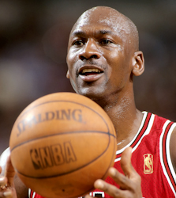
Signs of Hyperactivity and Impulsivity
Interrupts, may blurt out answers prematurely
Fidgeting, tapping, squirming in seat
Eager to be “on the go“
Appears to not listen
Difficulty being quiet
May talk excessively
Impatient
Michael Jordan - Pro basketball player

Slide 29
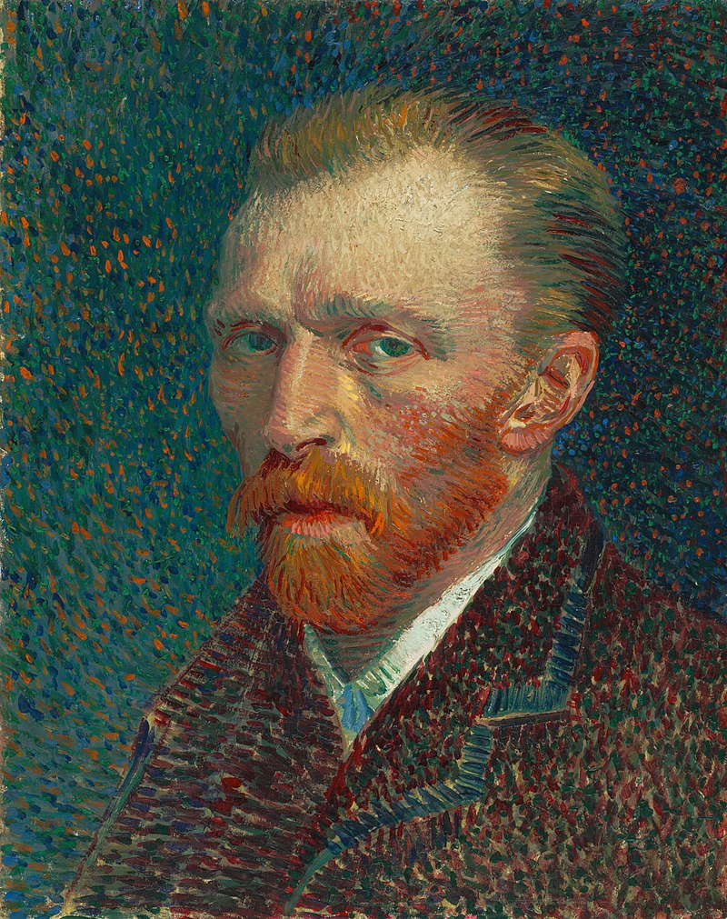
Signs of Inattentiveness
Inattentive types
Absorbed in thoughts
Forgetful
Poor attention to details
Easily distracted
Careless mistakes
Difficulty organizing tasks
Poor follow-through
Vincent van Gogh - Artist

Slide 30
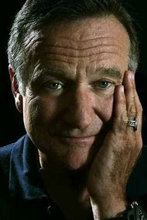
ADHD in the Classroom
Trouble keeping up with materials
Poor time management, missed deadlines
Frequent interruptions
May talk excessively
Difficulty sitting still
Careless mistakes
Inattentiveness
Impatience
Robin Williams – Actor and comedian

Slide 31
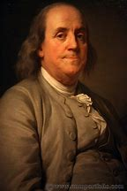
Strengths of a Person with ADHD
Creative strengths
Divergent thinking
Strong imagination
Conducive to FLOW state
(optimal brain performance)
Benjamin Franklin - One of the Founding Fathers of the United States, leading author, printer, political theorist, politician, postmaster, scientist, inventor, humorist, civic activist, statesman, and diplomat

Slide 32
Support for Students with ADHD
Quiet work area away from distractions
Opportunities for movement and tactile input
Clear and specific instructions
Breaking tasks into smaller parts
Sharing notes
Extended deadlines

Slide 33
Asperger’s
Syndrome
A subset of
Autism Spectrum Disorder
(ASD)
DYSLEXIA SLIDE TO MAKE BLANK

Slide 34
What is Asperger’s?
Asperger syndrome (AS) is a neurological, developmental disorder characterized by significant difficulties in social interaction and nonverbal communication, along with restricted and repetitive patterns of behavior and interests, issues of sensory overload, and is often combined with ADHD.
“It seems that for success in science or art,
a dash of autism is essential.”
‒ Dr. Hans Asperger (1906-1980)

Slide 35
Facts About Asperger’s
First described in the 1940s by Viennese pediatrician Hans Asperger
Asperger’s has been referred to as the ‘genius gene‘.
Approximately 1% of the population of the United States have Asperger’s syndrome. Many go undiagnosed.
Twice as many males as females have Asperger’s.
Asperger’s is a life-long condition.

Slide 36
More Facts About Asperger’s
35% attend college.
75-85% unemployment (poor interview and social skills)
Most experience strong empathy but have difficulty defining and expressing emotions.
More likely to be taken advantage of, bullied, and become victims of violent crimes
Also referred to as “high-functioning autism”
Dogs help improve independence, quality of life, and safety.

Slide 37
Signs of Asperger’s
Less severe symptoms than other forms of autism
Exceptional cognitive and language abilities at an early age
Obsession with topics of interest
Few facial expressions
Repetitive mannerisms
Avoidance of eye contact during conversation

Slide 38
More Signs of Asperger’s
Difficulty comprehending nonliteral words or phrases
Hyper-awareness of all senses (sound, light, clothing textures)
Sensory overload can trigger detachment
Struggles with anxiety
May misread social cues or facial expressions
Trouble understanding verbal and non-verbal language in social contexts

Slide 39
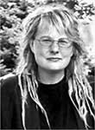
Challenges of Asperger’s
Not understanding what others are thinking and feeling
Difficulty with changes and transitions
Trouble asking for help
May be seizure prone
Time perception
Social anxiety
Dawn Prince-Hughes - Anthropologist

Slide 40
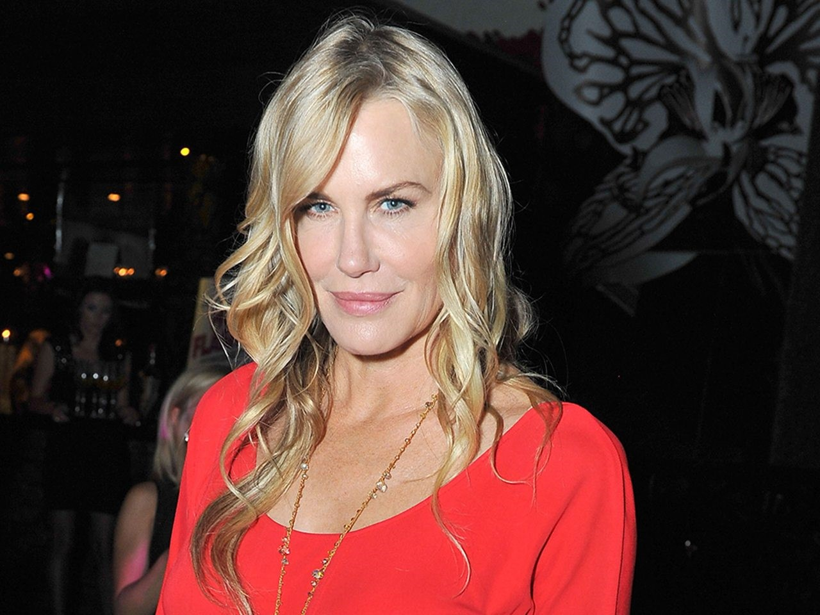
Asperger’s in the Classroom
Social anxiety, unexpected emotion when stressed
Difficulty talking to strangers or in group work
Sensory overload in large classes
May show repetitive behaviors
Intense focus on interests
Issues with organization
May appear inattentive
Daryl Hannah – Actress, environmental activist

Slide 41
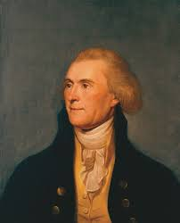
Strengths of a Person with Asperger’s
Ability to maintain prolonged focus on topics of interest
Excellent long-term and rote memory
Strong sense of fairness and justice
“Out of the box” thinking
High intelligence
Strong attention to detail
Noted for honesty
Thomas Jefferson - Statesman, diplomat, lawyer, architect, Founding Father, 2nd U.S. vice president, 3rd U.S. president, principal author of the Declaration of Independence

Slide 42
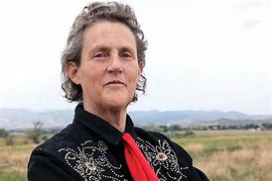
More Strengths
Reliable (once expectations are understood)
Build friendships through shared interests
Unique sense of humor
Specialized interests
Feel things deeply
Detail oriented
Temple Grandin - Professor of animal science at Colorado State University, autism spokesperson

Slide 43
Support for Students with Asperger’s
Additional ways to participate (discussion board, office visits)
Step-by-step assignments to strengthen executive functioning
Quiet testing environment, headphones, lighting
Predictable class routine

Slide 44
More Support
Provide explicit instructions and printed notes.
Do not force eye contact, as many experience it as painful.
Allow use of laptop in classroom.
Allow student to leave class when overwhelmed.
Advisors: Start with fewer classes, smaller classes.

Slide 45
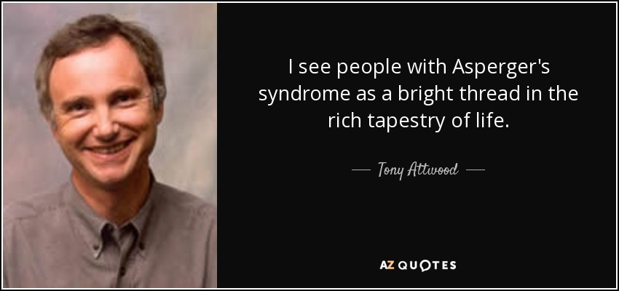

Slide 46
What did I discover,
and why is it meaningful?

Slide 47
What did I discover,
and why is it meaningful?
The findings confirmed and expanded my understandings of these topics, including the fact that each person will experience their condition in a unique and subjective way. This is important because it speaks to the complexity of such conditions.
The ongoing increase of prevalence for all neurodiverse conditions is surprising information, and it reiterates the importance of taking action now.
Notes:
What did I discover instead, and why is that discovery meaningful?
I found that there was a difference between the support systems of two- and four-year institutions.
I found increase in neurodiversity nor the challenges they face.
I found that there is no standard definition for neurodiversity or the conditions that accompany it. These conditions are unique experiences and There can be considerable diversity between individuals.
I discovered that to know more about this topic I would have to expand from looking at rural community colleges to higher institutions.
By looking at a large span of best practices (including the United Kingdom and Australia), we found numerous practices that could be implemented with only the investment of human effort and commitment. Commodity
At the beginning, I expected to find that increasing awareness and supports would be out of our reach due to lack of funding. Instead, I found multiple ways that communities can work around many of these supports.
I expected information about neurodiversity would be difficult to collect. I underestimated how far-reaching the neurodiversity movement has come in bringing these issues to the forefront. Rich, detailed information is now available online. Several organizations have assembled to address specific neurodiverse conditions and offer advice to improve educational opportunities and outcomes. Even within the 9 months of working on this project, the literature base and public accessible information base grew.
Several scholarships are available to neurodiverse students.

Slide 48
Discovery, Cont.
As I moved from comparison of rural community colleges to 4-year universities (United States, United Kingdom, Australia),
    I found that many best practices used to serve the neurodiverse population could be adjusted and implemented within rural community college settings at little to no financial expense.

Slide 49
Discovery, Cont.
In order to achieve this, a significant community investment of time and support is required. The rural community college is the home-base for our friends and families, neighbors and fellow learners. We are all stakeholders in the success of one another.
The first steps, then, are to present information, start conversations, and brainstorm possible solutions to some of our service needs.

Slide 50
What Next?
How do we provide the best learning experiences for neurodiverse students
without special funding?

Slide 51
To be creative and willing to help
…requires a united effort and commitment from
Community
Local businesses
Administration
Faculty
Student body
Neurodiverse students

Slide 52
Brainstorming & Sharing Ideas
Faculty-led seminars of interest
Club-sponsored workshops that offer social support
Explore ‘Universal Design Learning’ (supplies clarity of instruction and opportunities to improve executive function skills)
Internships and shadowing opportunities from the business community

Slide 53
Self-Advocacy
The #1 predictor of future educational and workplace success is opportunity for neurodiverse students to develop self-advocacy.

Slide 54
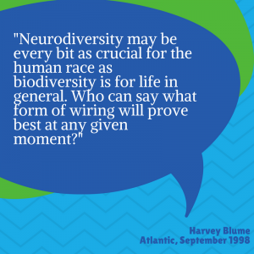
Q&A

Slide 55
Most of all…
We can all do something to make a difference.
Be a conversation starter.

Slide 56
References
Armstrong, T. (2011). The power of neurodiversity: Unleashing the advantages of your differently wired brain. Cambridge, MA: Da Capo Press.
Armstrong, T. (2012). Neurodiversity in the classroom: Strength-based strategies to help students with special needs succeed in school and life. Alexandria, VA: Association for Supervision and Curriculum Development.
Attention-deficit / hyperactivity disorder (ADHD): Data and statistics about ADHD. (2018). Centers for Disease Control and Prevention. Retrieved from https://www.cdc.gov/ncbddd/adhd/data.html
Austin, R. D., & Pisano, G. P. (2017, May-June). Neurodiversity as a competitive advantage. Harvard Business Review. Retrieved from https://hbr.org/2017/05/neurodiversity-as-a-competitive-advantage
Autism spectrum disorder: What is autism spectrum disorder? (2018). Centers for Disease Control and Prevention. Retrieved from https://www.cdc.gov/ncbddd/autism/facts.html
Casanova, M. (2013). Dyslexia, attention deficit hyperactivity disorder and autism. Retrieved from https://corticalchauvinism.com/2013/05/06/dyslexia-attention-deficity-hyperactivity-disorder-and-autism/
Child development: Learning disorders in children. (2019). Centers for Disease Control and Prevention. Retrieved from https://www.cdc.gov/ncbddd/childdevelopment/learning-disorder.html

Slide 57
References, Cont.
Diamond A. (2012). Executive functions. Annual review of psychology, 64, 135–168. doi:10.1146/annurev-psych-113011-143750
Eide, B. L., & Eide, F. F. (2011). The dyslexic advantage: Unlocking the hidden potential of the dyslexic brain. New York, NY: Penguin Group.
Georgetown University Medical Center. (2015, February 12). A brain system that appears to compensate for autism, OCD, and dyslexia. ScienceDaily. Retrieved from www.sciencedaily.com/releases/2015/02/150212154635.htm
Grandin, T. (2012). Different not less: Inspiring stories of achievement and successful employment from adults with autism, Asperger's, and ADHD. Arlington, TX: Future Horizons.
Grandin, T., & Panek, R. (2013). The autistic brain: Helping different kinds of minds succeed. New York, NY: Mariner Books.
Hendrickx, S. (2010). The adolescent and adult neurodiversity handbook. London, England: Jessica Kingsley Publishers
Johnson, M. S. E., & Nuttall, J. (2015). Dyslexia & college success. Scotts Valley, CA: CreateSpace Independent Publishing Platform.

Slide 58
References, Cont.
Landmark College: The college of choice for students who learn differently. (2019). Landmark College. Retrieved from https://www.landmark.edu/
Morin, A. (2019). Autism vs. learning and attention issues: What you need to know. Retrieved from https://www.understood.org/en/learning-attention-issues/getting-started/what-you-need-to-know/autism-vs-learning-and-attention-issues-what-you-need-to-know
Morin, A. (2019). The difference between ADHD and autism. Retrieved from https://www.understood.org/en/learning-attention-issues/child-learning-disabilities/add-adhd/the-difference-between-adhd-and-autism
Neurobehavior disorders. (2019). NorCal Brain Center. Retrieved from https://norcalbrain.com/symptoms/neurobehavioral-disorders/
Neurodiverse (Aspergers, ADHD, dyslexia, dyspraxia). (2019). [Meetup page]. Retrieved from https://www.meetup.com/ADHD-ADD-Manchester-Meetup/
New horizons academy: Bringing learning to life! (2018). New Horizons Center for Learning. Retrieved from https://www.newhorizons.vegas/
Packman, K. (n.d.). Aspergers, ADHD & dyslexia. [Blog post]. Retrieved from http://kentpackman.tumblr.com/

Slide 59
References, Cont.
Related conditions. (2018). National Autistic Society. Retrieved from https://www.autism.org.uk/about/what-is/related-conditions.aspx#
Russell, G., & Pavelka, Z. (2013). Co-occurrence of developmental disorders: Children who share symptoms of autism, dyslexia and attention deficit hyperactivity disorder. Retrieved from https://www.intechopen.com/books/recent-advances-in-autism-spectrum-disorders-volume-i/co-occurrence-of-developmental-disorders-children-who-share-symptoms-of-autism-dyslexia-and-attentio
Silberman, S. (2016). Neurotribes: The legacy of autism and the future of neurodiversity. New York, NY: Penguin Random House LLC.
Stoodley, C. J. (20 May 2014). Distinct regions of the cerebellum show gray matter decreases in autism, ADHD, and developmental dyslexia. Frontiers in Systems Neuroscience (8)92. https://doi.org/10.3389/fnsys.2014.00092
www.autism-society.org/what-is/aspergers-syndrome/

