Slide 1
Relativity in Motion:
How Newton and Einstein Changed Science
Jediah Dillon
April 22, 2026
Notes:
Introduction: name, major, graduation date.

Slide 2
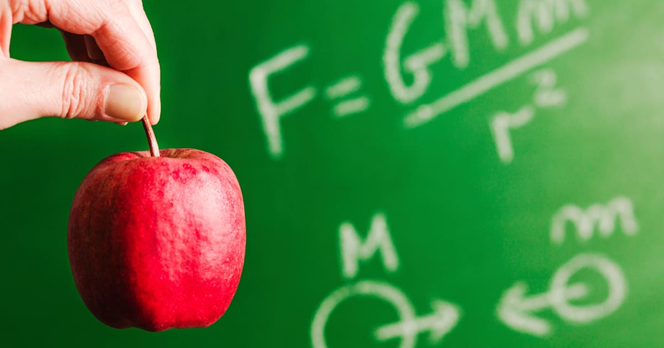
What did I study? Why is it important?
Notes:
I studied both Isaac Newton and Albert Einstein’s world machines. Looking into the physics and mathematics that allow us to understand not only how the universe works. But gives us helpful everyday tools like the GPS.

Slide 3
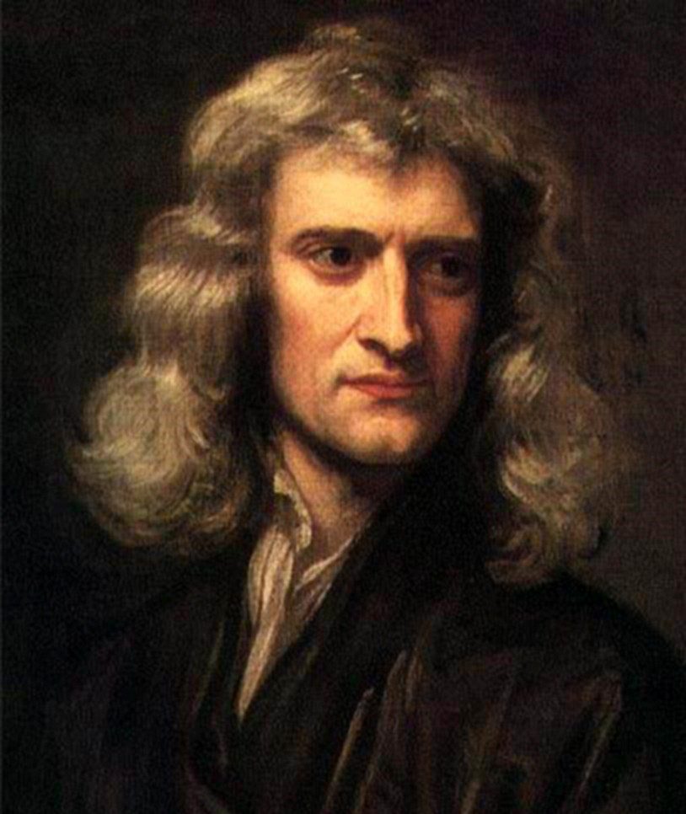
Isaac Newton
“If I have seen further, it is by standing on the shoulders of giants."
Gravity
Laws of Motion
Calculus
Alchemy
Chemistry
"Sir Isaac Newton" by aldoaldoz is licensed under CC BY-NC-SA 2.0.
Notes:
Isaac Newton, the pioneer of gravity, calculus, and bridged the gap between alchemy and chemistry. Now, people knew about gravity before Newton “discovered” it, it was just that Newton was the first to question it. His quote shows us that what he worked on was only possible because of those who worked before him.
So, what was Isaac Newton like? How did he come to develop his laws, and what did he do after? Well, let me show you in the form of an animated short.

Slide 4
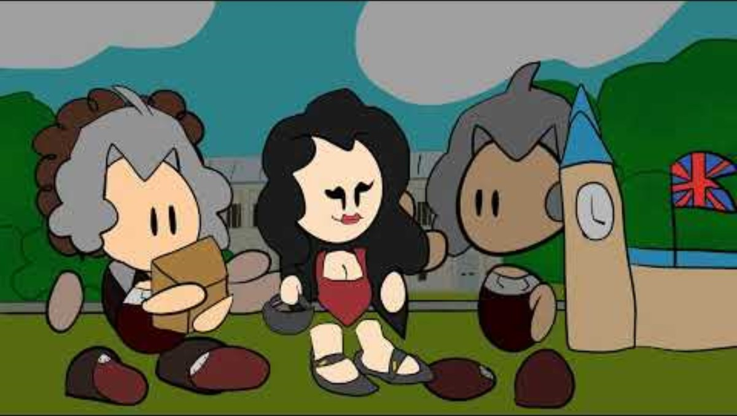
Isaac Newton Animation

Slide 5

Newton’s Apple Tree
Still alive, 300 years old
Sapling transported and grown in Washington D.C.
Apple cider made by Newton’s descendants

Slide 6
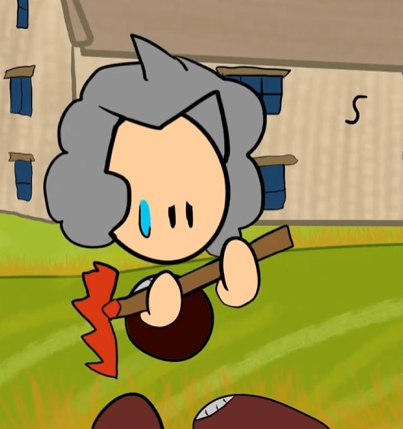
Newton’s Miracle Year
1666 at age 23
Law of universal gravitation
Laws of Motion
Theory of color

Slide 7
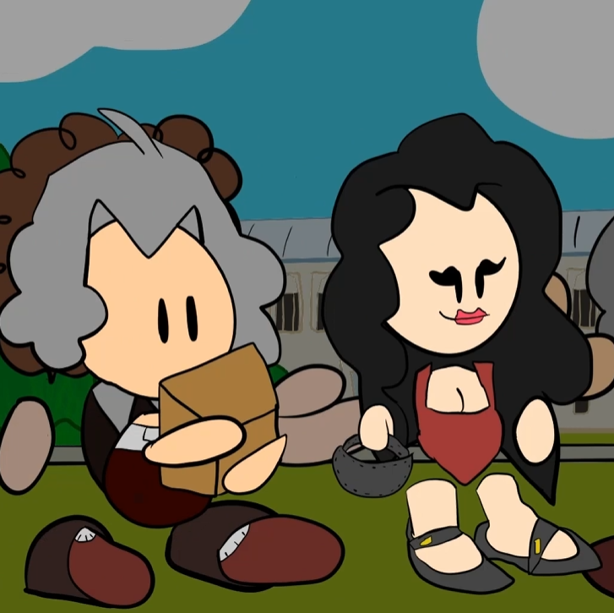
Catherine Barton
Newton’s step-niece
“Hostess” for Newton
Love?

Slide 8
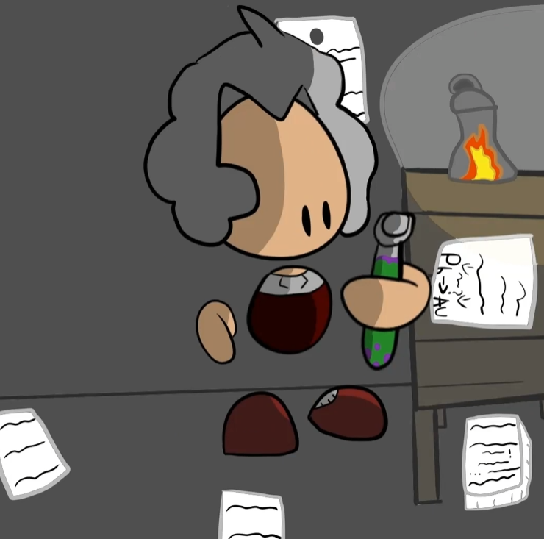
Later Life
Alchemy
Secrecy
Philosopher’s stone

Slide 9
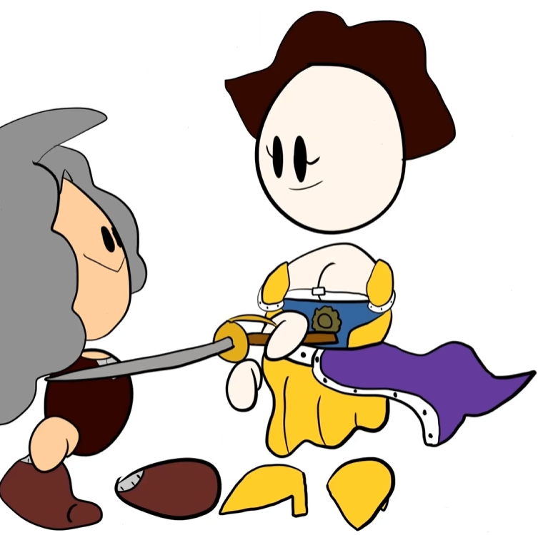
Knighted
Involved in the Great Recoinage Act of 1696
Likely not knighted because of his scientific accomplishments

Slide 10

Newton’s Law of Universal Gravitation
Gravitational Constant
Inverse-Square Law
Mass Dependence
Notes:
Newton’s law of universal gravitation attempts to explain why gravity occurs. Newton tells us that force is equal to the gravitational constant times the mass of object 1 times the mass of object 2 divided by the radius squared.
The gravitational constant dictates the strength of gravity between two objects.
The inverse-square law is a specified physical quantity that is inversely proportional to the square of the distance from the source.
Let’s use gravity as an example. The force of gravity between two objects decreases as the square of the distance between their centers increases.
Mass dependence shows us how physical properties or behaviors are affected by changes in mass. We will see more on how mass changes when we talk about inertia and relativity.
Now that we’ve looked at Newton’s law of gravitation, let’s move our attention onto his laws of motion.

Slide 11

Newton’s Three Laws of Motion
1. Law of Inertia
1
2. Second Law
2
Force = Mass x Acceleration
3. Third Law
3
Action and reaction
Objects in motion stay in motion
Notes:
Law of Inertia: Objections in motion stay in motion unless acted upon by another force. This law gives us the idea of friction, which explains why when something slides on a surface, it does not slide forever. Something will slide further on ice than on concrete because ice has less friction.
Second Law: Force = Mass x Acceleration. This law tells us how much force is needed to accelerate something with a higher or lower amount of mass. (← work on this future me)
Third Law: Every action has an equal and opposite reaction. When you walk, your foot pushes onto the ground and the ground pushes back. If you push on a table, the table pushes back.

Slide 12
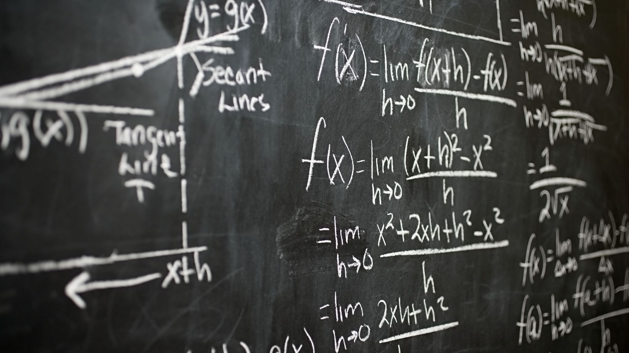
Newton’s Calculus
Rates of change
Designed to calculate instantaneous change
Notes:
Unlike Leibniz’s calculus, Newton independently created his own version to solve physics problems. Newton’s calculus centers around rates of change, which is designed to calculate and plot instantaneous changes of speed, placement, etc. on a slope.
We know Newton did not have many students, but he did have an unbelievable impact on future mathematicians. Let’s take a look at that.

Slide 13
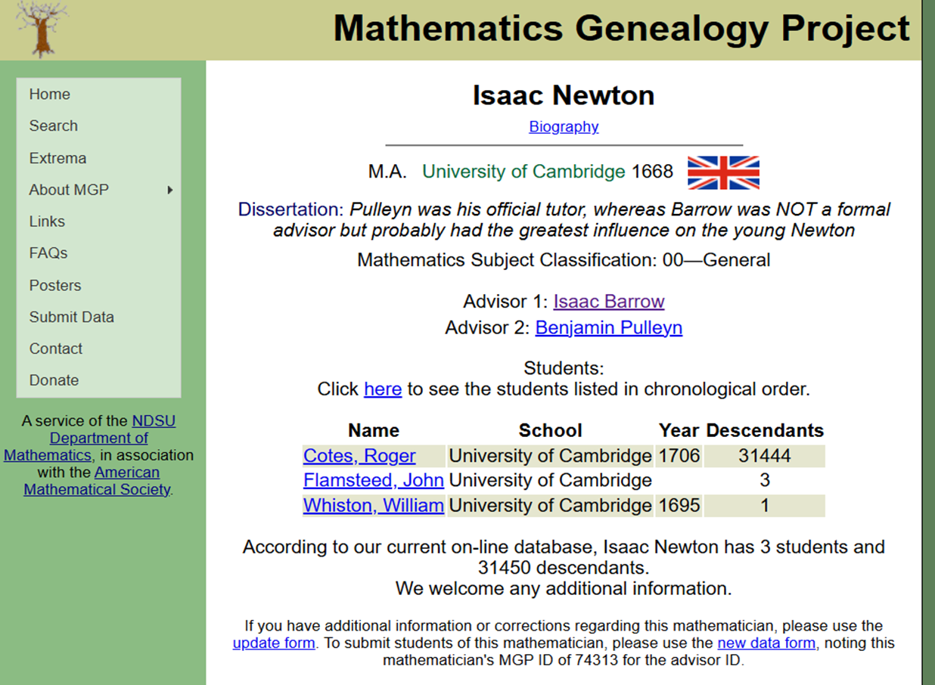
Math Genealogy Project
Notes:
For a fun detour, according to the Mathematics Genealogy Project shows us that when Isaac Newton was teaching at Trinity College, he had three students who also pursued an advanced degree in mathematics. Roger Cotes would go on to teach, and his students taught, leading to a ripple effect where now Newton has almost 32,000 math descendants and is still going on today. Also, the reason Newton got a master’s and not a PhD is only because Cambridge University did not offer one at that time.
Einstein has no recorded students who received PhD’s in math.
That was Isaac Newton, recall that we went over his law of universal gravitation, laws of motion, calculus, and his life. Now, lets take a look at Albert Einstein.

Slide 14
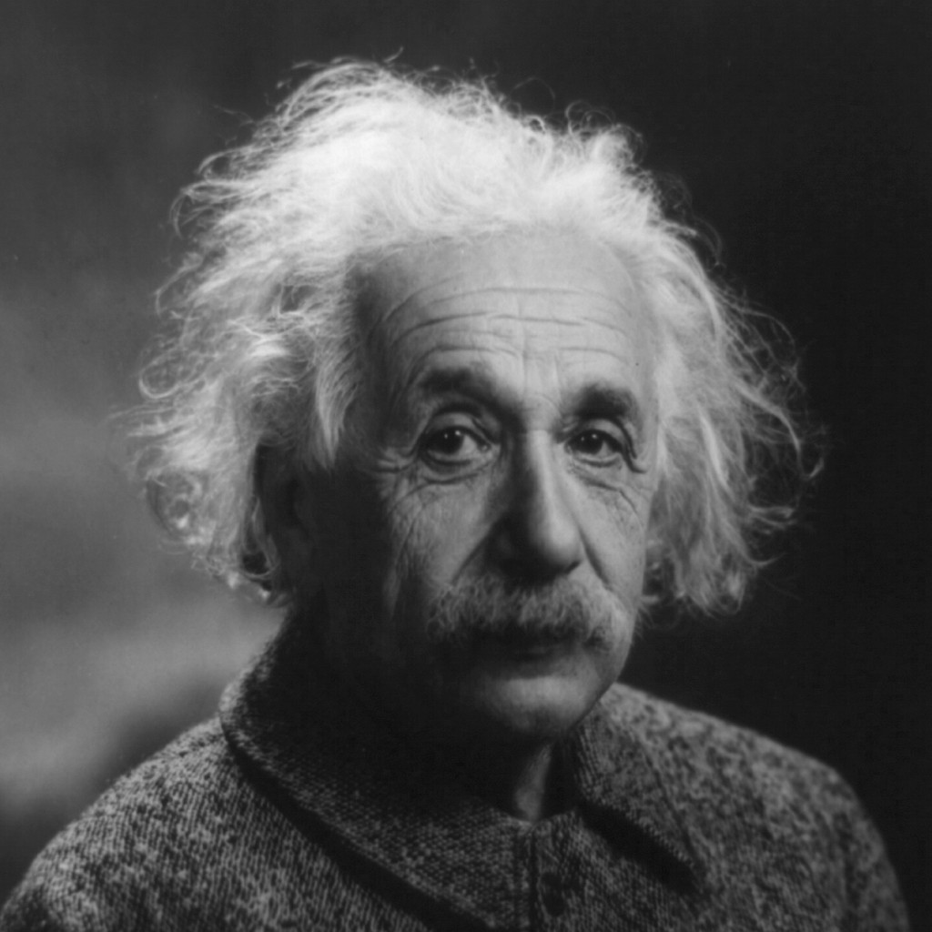
Albert Einstein
"I have no special talents. I am only passionately curious."
Special Relativity
General Relativity
Mathematical Equations
Corrections to Newton’s Laws of Motion
"Albert Einstein" by ThomasThomas is licensed under CC BY-NC 2.0.
Notes:
Albert Einstein, the one who challenged the general consensus of the universe. His world machine showed us that space and time are not constants like everyone assumed. Instead, they depend on the strength of gravity acting upon a certain thing or individual.
Einstein was certainly a unique character. Let’s take a look at his life like we did with Newton.

Slide 15
Albert Einstein Animation
Animation goes here ☺

Slide 16
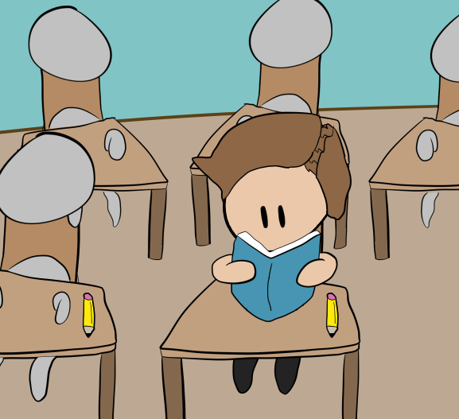
Einstein's Early Life
Mute until age 4
Excelled in mathematics and physics
Struggled with languages, arts, etc.

Slide 17
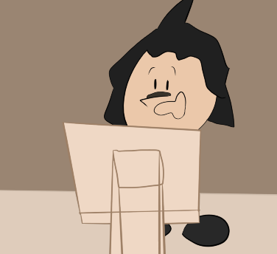
Einstein’s Miracle Year
1905 at age 26
Special relativity
Brownian motion

Slide 18
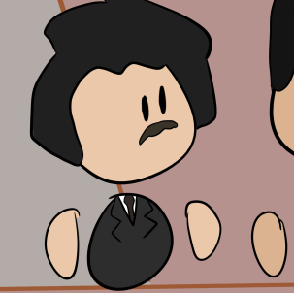
Nobel Prize
Worked with his wife, Mileva Marić, on relativity
Won the 1921 Nobel Prize in physics but was not awarded it until 1922
Gave the prize money to Mileva Marić so they could divorce and Einstein could marry his cousin

Slide 19

Special Relativity
Deals with speed
Space and time are not constants, but relative
Train thought experiment
Theory of simultaneity
“When you are courting a nice girl an hour seems like a second. When you sit on a red-hot cinder a second seems like an hour. That's relativity.”
Notes:
Special relativity was one of Einstein’s first published works during his miracle year. It focuses on how measurements of space and time change at high speeds. It also tells us that space and time are not constant, but relative to whoever experiences it. Einstein’s quote shows us that relativity isn’t just math, but there is also a bit of psychology to it. Einstein explained special relativity using trains and lightning. Say a lightning bolt strikes both ends of a train at the same time, someone standing on the ground would say the lightning struck at the same time, while someone riding the train would say one struck before the other. Showing us that even if things happen simultaneously, they appear different to the individual who experiences it. This is called Relativity of simultaneity, a central idea in special relativity.
After special relativity, Einstein went on to work on general relativity. Let’s take a look at that.

Slide 20

General Relativity
Deals with gravity
Gravity is not a force
Einstein’s Spacetime
Massive objects curve spacetime, and objects move along those curves
Notes:
Einstein’s general relativity shows us that gravity, unlike what Newton assumed, is not a force. Gravity is the curvature of spacetime. Massive objects curve spacetime, and objects move along those curves. General relativity also explains Mercury’s orbit, as the high gravity of the Sun causes Mercury’s ellipse to rotate slightly faster than Newtonian physics predicted. Einstein’s way of explaining general relativity and spacetime is in the form of a stretched sheet with a heavy object placed on top. This creates a dip, in which smaller objects rolling nearby will curve towards it.
In special and general relativity, we saw that both speed and gravity can affect time. That is called time dilation.

Slide 21
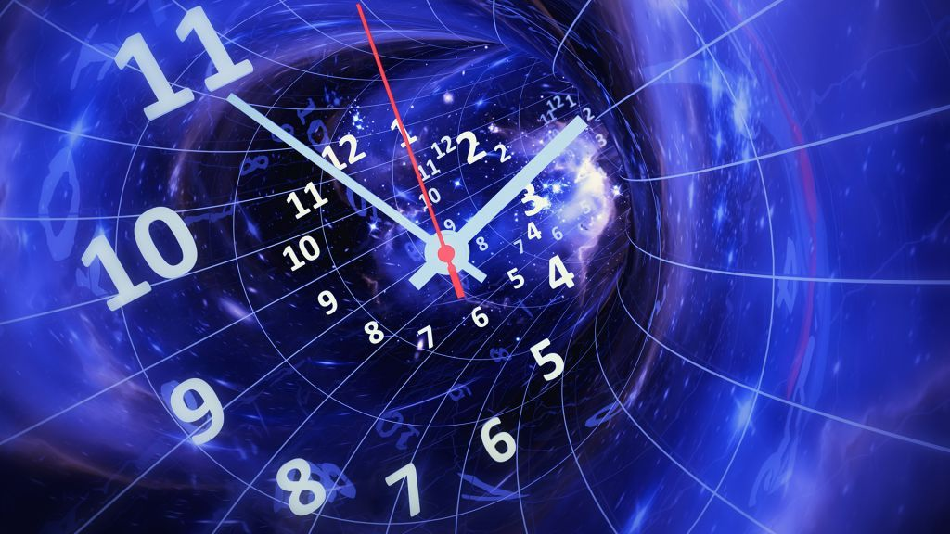
Time Dilation
Time is not a constant, it is relative.
Object in a strong gravitational field experiences time slower (e.g. clouds, airplanes, etc.)
Notes:
Time dilation was easily the most interesting thing I studied for this project. It is included in both special and general relativity and, as mentioned before, shows us that time is not a constant like people assumed before. A thing or individual experiencing stronger gravity will experience time slower than something in a weaker gravitational field. For example, if you lived on Jupiter, you age slower than living on Earth due to Jupiter’s stronger gravitational field.
Time dilation is also what gives us accurate GPS’s, as the satellites are in a weaker gravitational field so they experience time faster, which would cause delayed signals, but because we know about time dilation, we are able to adjust for it.

Slide 22
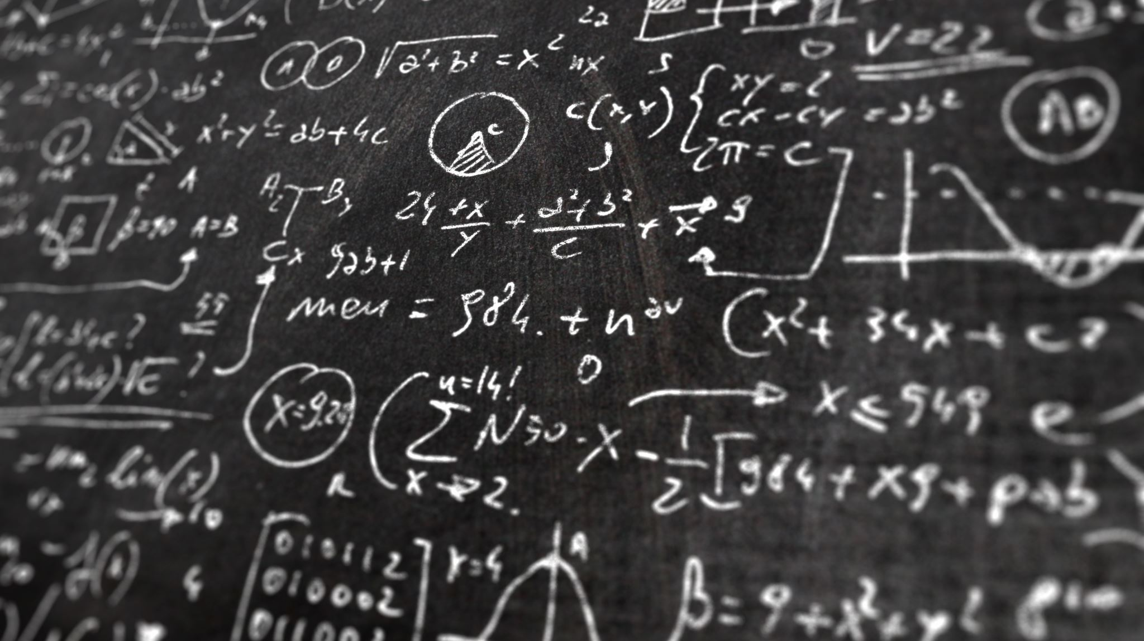

Einstein’s Mathematics
${E=mc}^{2}$
Energy = Mass x ${Speed of Light}^{2}$
Mass Energy Relations
Key equation for nuclear weapons (Manhattan Project)
Time Dilation
Notes:
Einstein’s mathematics work because of his theory of special and general relativity. E=mc2, which was Einstein’s way to prove that mass and energy are part of the same system instead of being governed by separate laws. This equation shows that mass and energy are interchangeable, which can result in a small amount of matter being converted into a tremendous amount of energy. This explains how stars shine and how nuclear weapons function.

Slide 23
Newton’s Influence on Einstein
"Newton, forgive me; you found the only way which, in your age, was just about possible for a man of highest thought and creative power."
Einstein’s changes to Newton’s laws of motion
Notes:
How do they connect? Isaac Newton built the framework. Einstein showed us its limits and what lies beyond them. Newton’s laws are an approximation. Einstein found out that they break down under extreme conditions, such as high speeds and high gravity as time and space are not constants like Newton assumed.
Newton’s second law, Force = Mass x Acceleration works under most circumstances, but becomes more complex at higher speeds. However, this does not mean that Einstein proved Newton’s laws incorrect, he only used recent scientific discoveries to prove that Newton’s framework needed more and were not fully complete. In fact, nothing in science is truly complete. Everything is falsifiable, meaning that one day, maybe another hundred years, someone will prove Einstein’s theory of relativity incomplete like Einstein did for Newton.

Slide 24
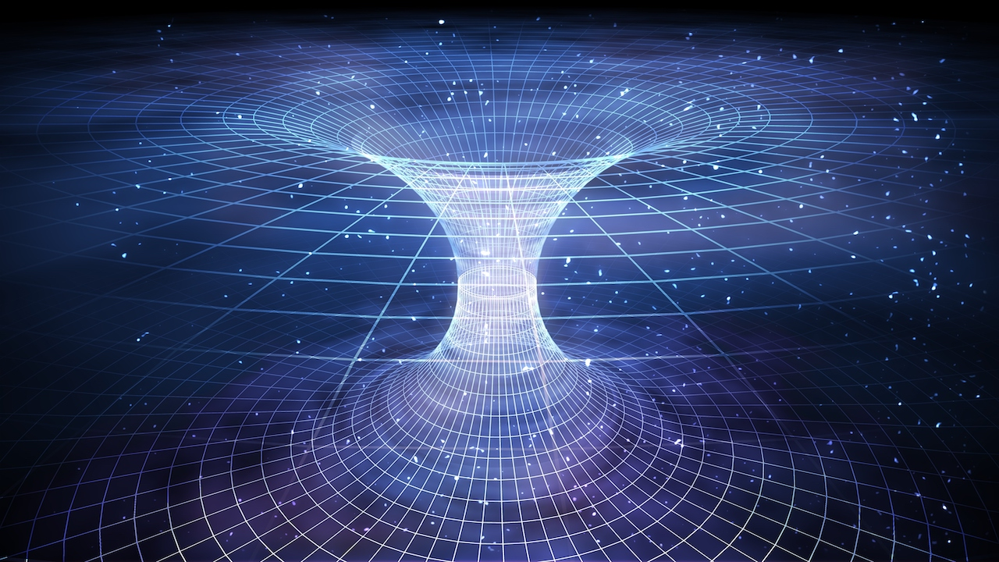
What did I expect to find?
Notes:
What did I expect to find? To be honest, I expected to find the expected. When I started, I believed Newton’s story of the apple. I had no reason to doubt the guy. (<— funny joke could be removed) I knew almost nothing about what Einstein worked on, so I did not expect much.

Slide 25
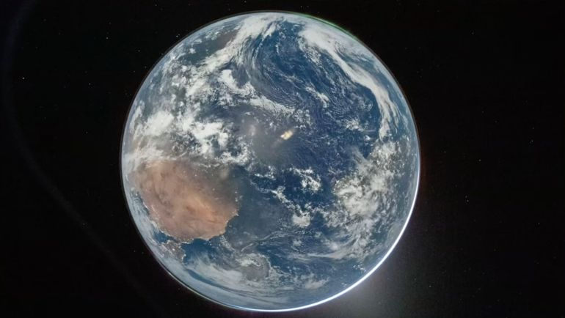
Why is it valuable?
Notes:
Why is it valuable? From Newton’s laws to Einstein’s theories, these great scientists shape how we understand the universe as a whole. Newton’s quote, standing in the shoulders of giants, shows us that his work was only possible because of those before him. Same with Einstein, and whoever is next.
Where is it heading?
We saw earlier that Newton worked with alchemy, trying to turn lead into gold. Scientists recently have found a way to turn a molecule of lead into a molecule of gold. While it is expensive and not really feasible right now, it is interesting to see something that Newton worked on hundreds of years ago becoming reality. How long will it take until it is fully possible? Who will be the next person to look at Einstein’s theory of relativity and find inconsistencies in it like what Einstein did with Newton’s laws of motion and gravitation.

Slide 26
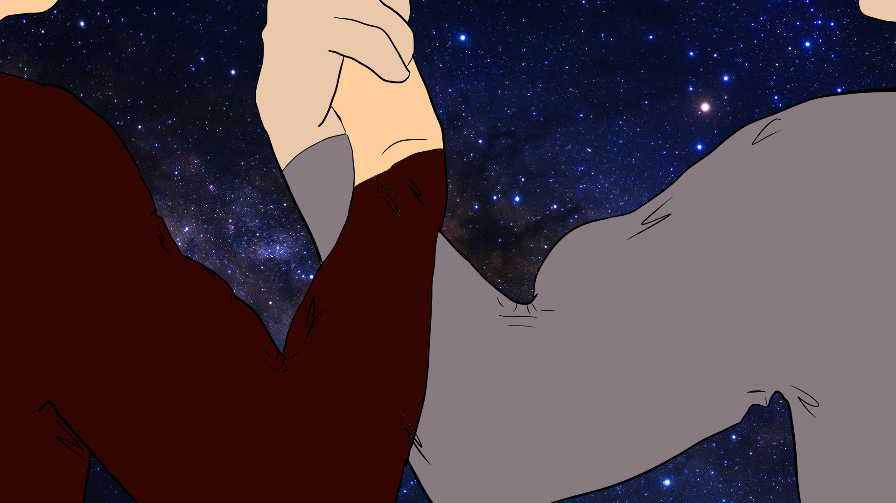
End

Slide 27
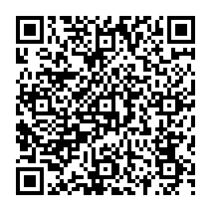
References

